Slide 1
Lecture 7 - Burgers’ Equation & Characteristics
Omer Bromberg
omerbr@tauex.tau.ac.il
Winter 2025/6
Modified from lecture notes by Michael Zingale & Cyrus Dreyer

Slide 2
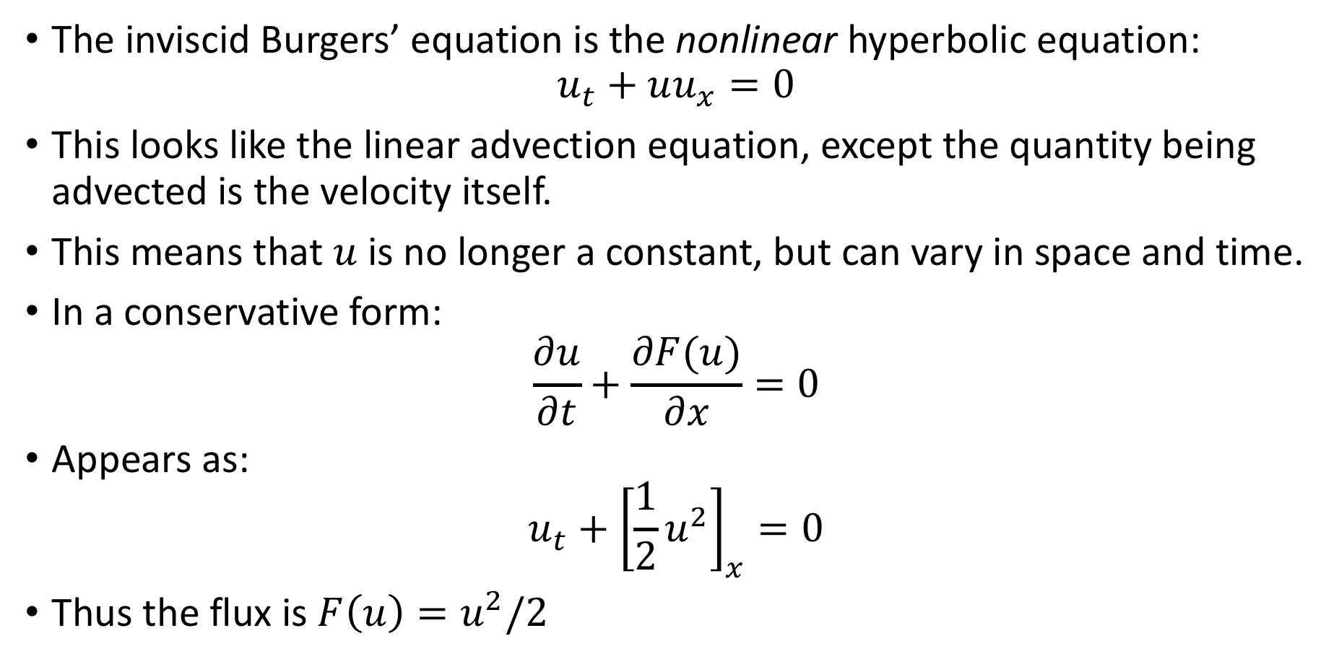
Burgers’ Equation
The inviscid Burgers’ equation is the nonlinear hyperbolic equation:
$$u_{t}+uu_{x}=0$$
This looks like the linear advection equation, except the quantity being advected is the velocity itself.
This means that $u$ is no longer a constant, but can vary in space and time.
In a conservative form:
$$\frac{∂u}{∂t}+\frac{∂F(u)}{∂x}=0$$
Appears as:
$$u_{t}+{\left[\frac{1}{2}u^{2}\right]}_{x}=0$$
Thus the flux is $F\left(u\right)=u^{2}/2$

Slide 3

Burgers’ Equation
In the finite volume approach, we integrate over the volume of a cell to get the update:
$$\frac{∂{\left\langle u\right\rangle }_{i}}{∂t}=−\frac{1}{Δx}\left(F_{i+1/2}−F_{i−1/2}\right)$$
To second order accuracy, as we saw previously, ${\left\langle u\right\rangle }_{i}≈u_{i}$, so we’ll drop the ⟨⟩ from here on.

Slide 4
Nonlinear behavior & shock formation
The solution method is essentially the same, aside from the Riemann problem.
Using the upwind method for the reconstruction is problematic
The equation is non linear, so information can “pile up” and we lose track of where the flow is coming from.
This situation is called a shock.

Slide 5
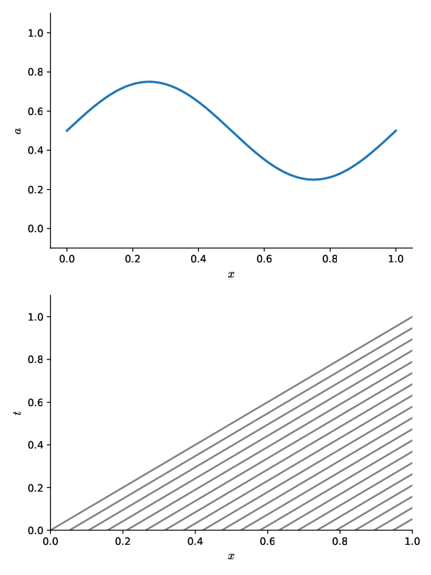

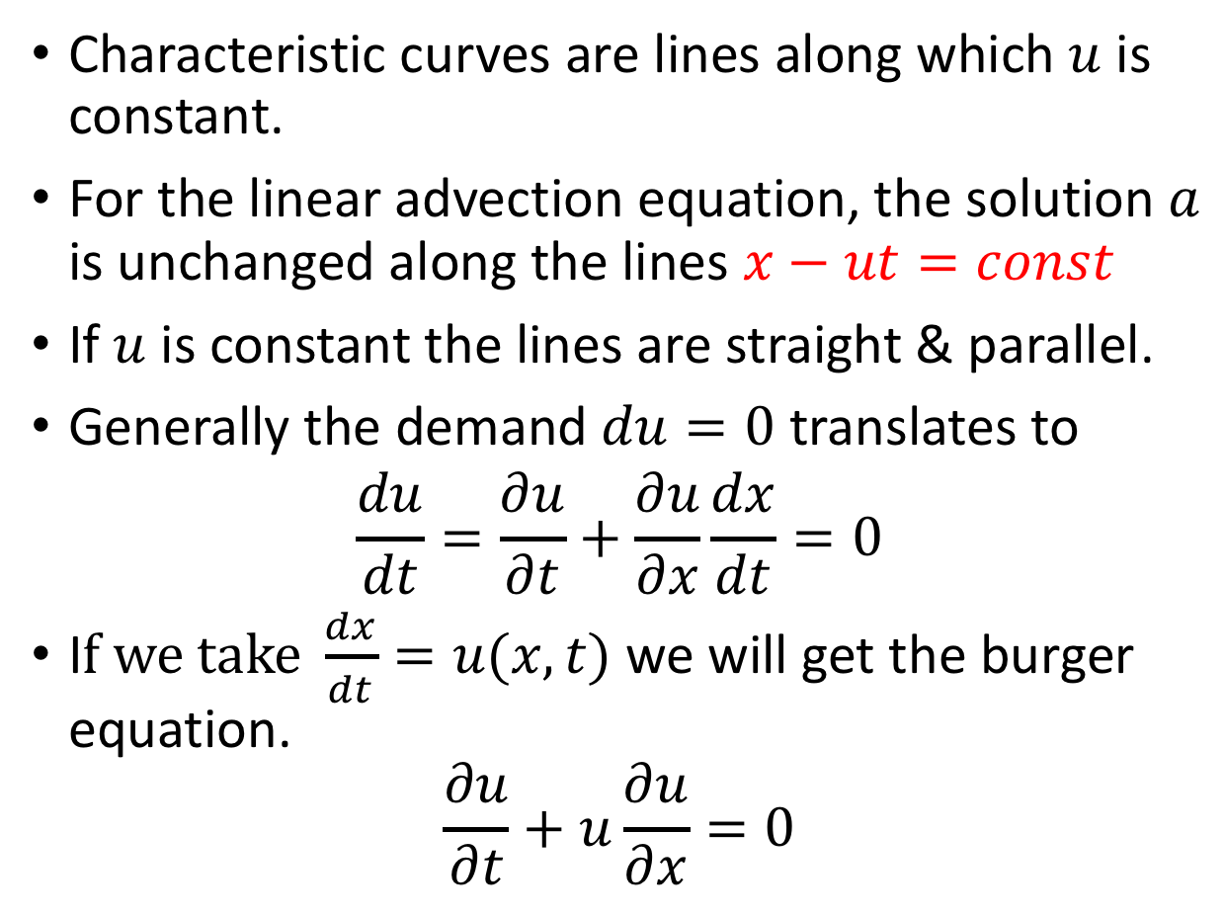




Characteristic curves
Advection - $a$ vary , $u$ constant
$$a$$
Characteristic curves are lines along which $u$ is constant.
For the linear advection equation, the solution$a$ is unchanged along the lines $x−ut=const$
If $u$ is constant the lines are straight & parallel.
Generally the demand $du=0$ translates to
$$\frac{du}{dt}=\frac{∂u}{∂t}+\frac{∂u}{∂x}\frac{dx}{dt}=0$$
I$f we take \frac{dx}{dt}=u(x,t)$ we will get the burger equation.
$$\frac{∂u}{∂t}+u\frac{∂u}{∂x}=0$$
$$x$$
$$t$$
$$x$$

Slide 6
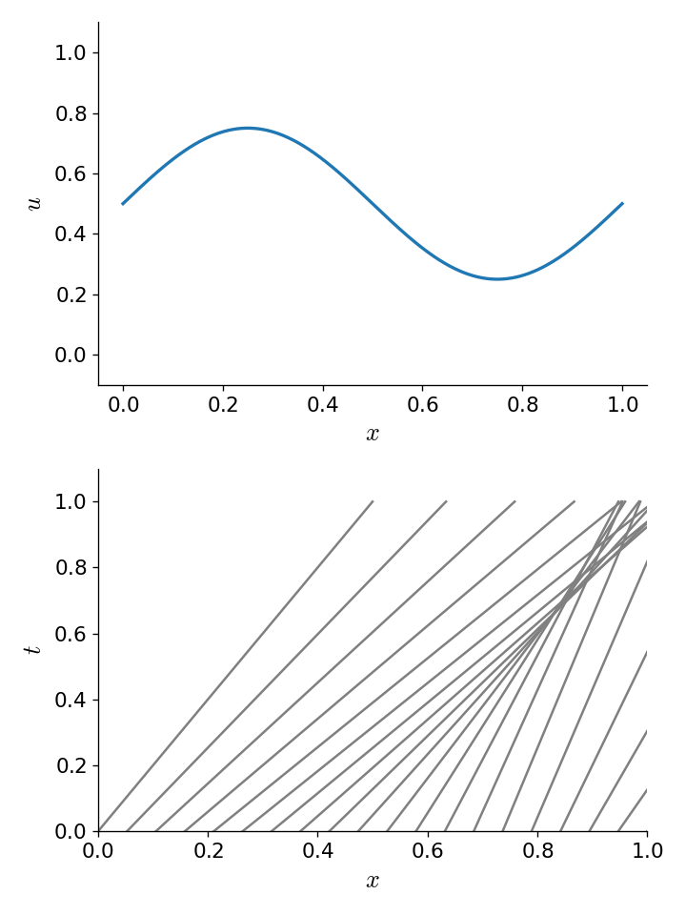

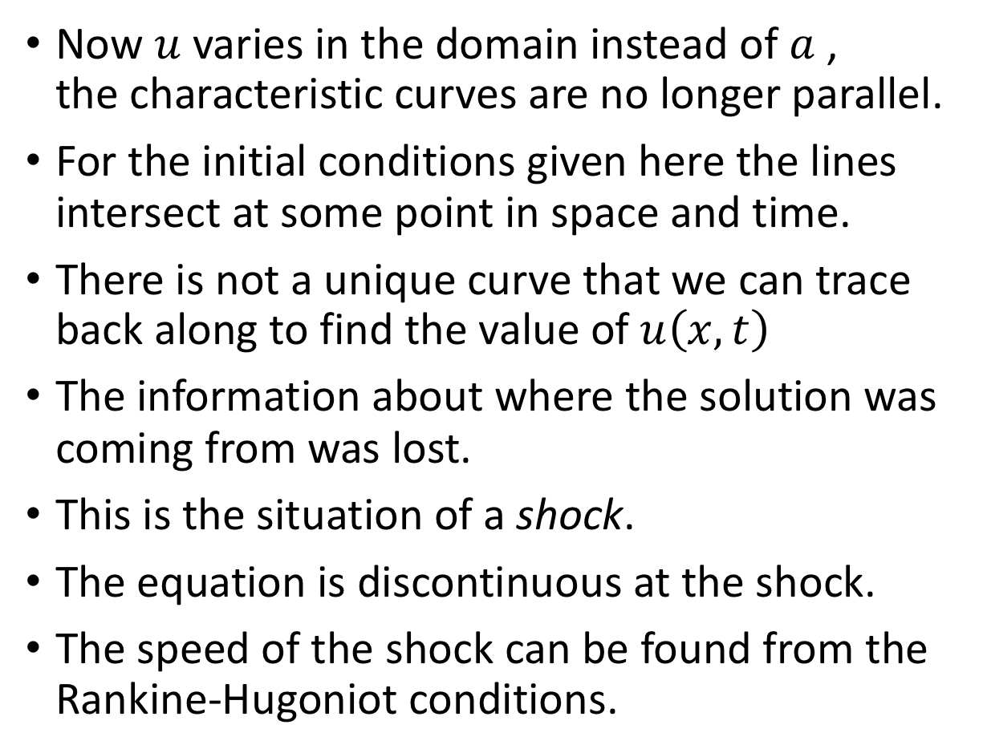




Characteristic curves
Burger - $u$ vary
Now $u$ varies in the domain instead of $a$ , the characteristic curves are no longer parallel.
For the initial conditions given here the lines intersect at some point in space and time.
There is not a unique curve that we can trace back along to find the value of $u\left(x,t\right)$
The information about where the solution was coming from was lost.
This is the situation of a shock.
The equation is discontinuous at the shock.
The speed of the shock can be found from the Rankine-Hugoniot conditions.
$$u$$
$$x$$
$$t$$
$$x$$

Slide 7
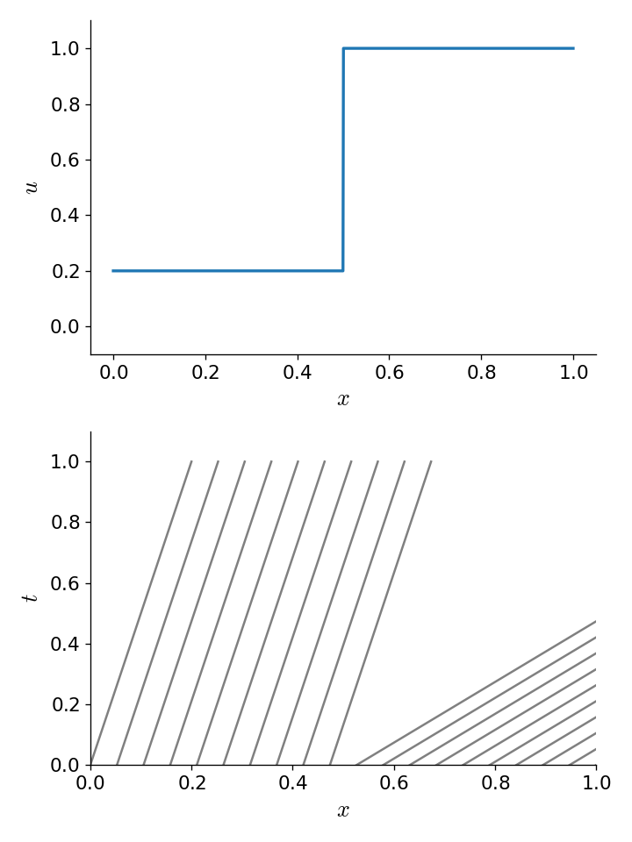


Characteristic curves
Burger - $u$ vary
It is also possible to get a rarefaction if the characteristics diverge.
$$u$$
$$x$$
$$t$$
$$x$$

Slide 8
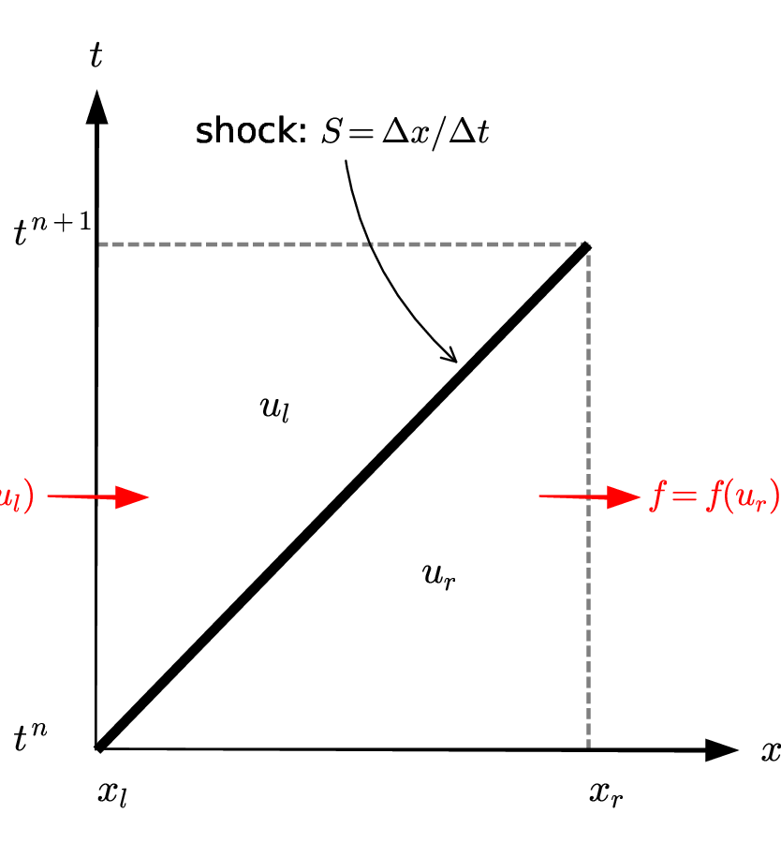
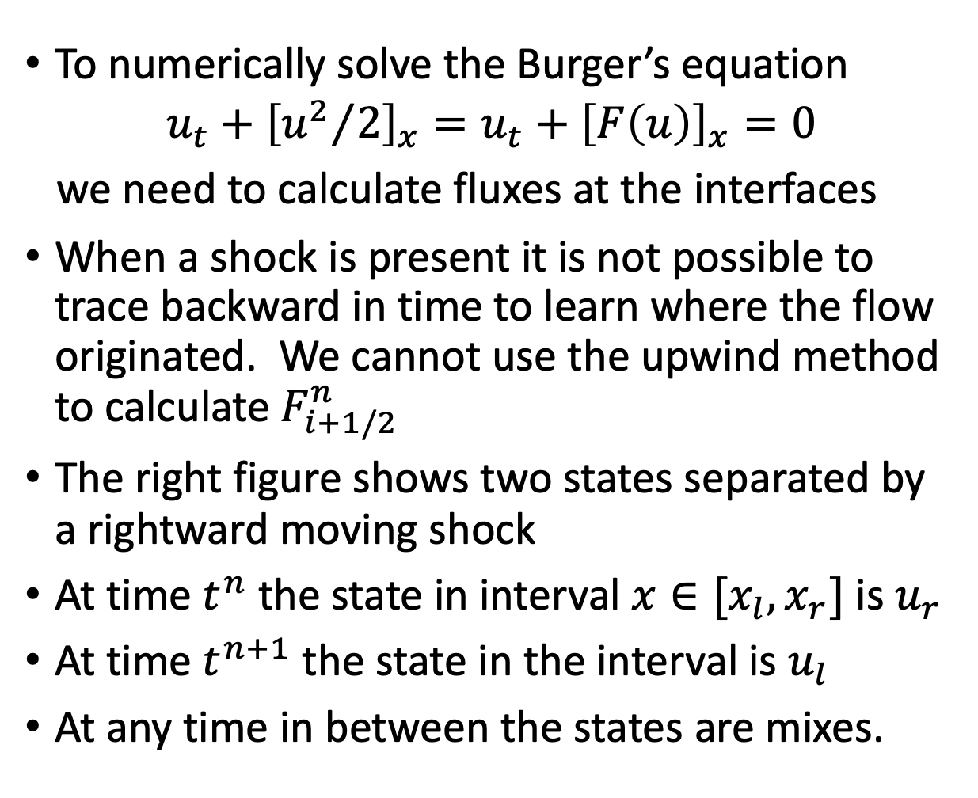


Burgers’ Riemann Problem
To numerically solve the Burger’s equation
$$u_{t}+{\left[{u^{2}}/2\right]}_{x}=u_{t}+{\left[F\left(u\right)\right]}_{x}=0$$
we need to calculate fluxes at the interfaces
When a shock is present it is not possible to trace backward in time to learn where the flow originated. We cannot use the upwind method to calculate $F_{i+1/2}^{n}$
The right figure shows two states separated by a rightward moving shock
At time $t^{n}$ the state in interval $x∈[x_{l},x_{r}]$ is $u_{r}$
At time $t^{n+1}$ the state in the interval is $u_{l}$
At any time in between the states are mixes.
$$f=f(u_{l})$$
$$f=f(u_{r})$$

Slide 9
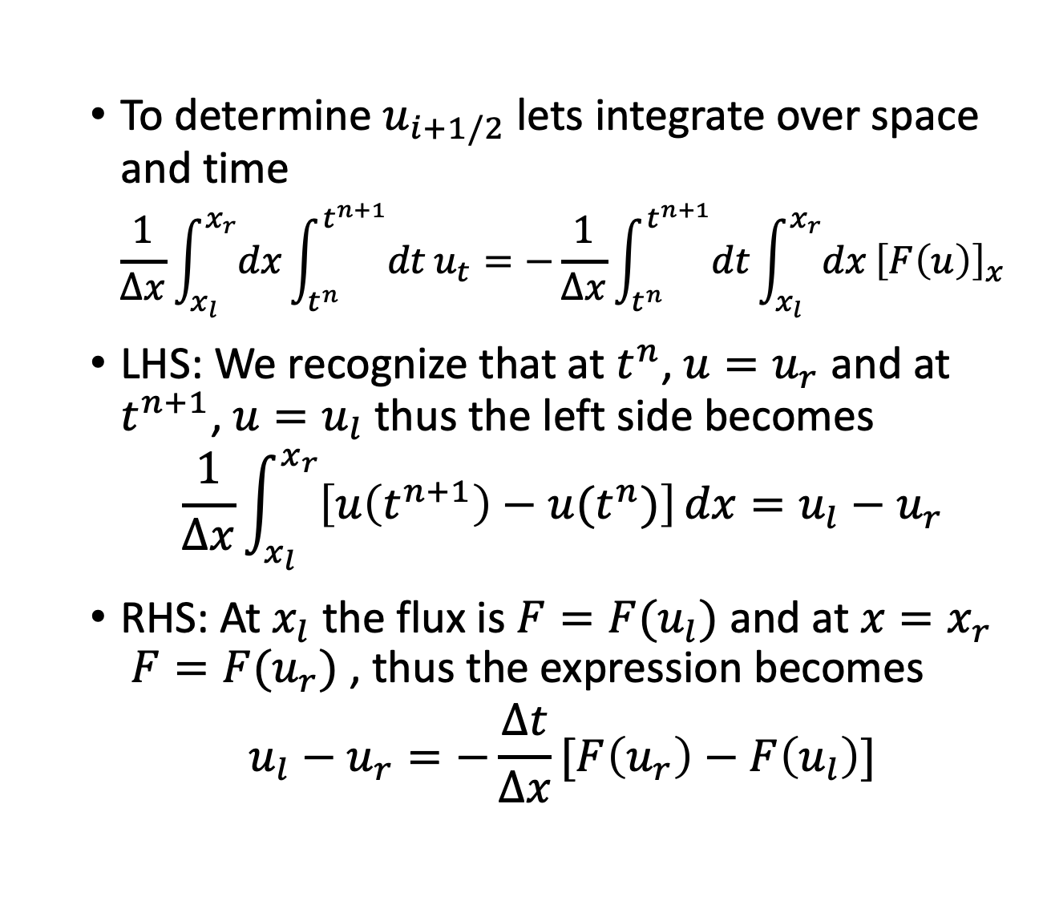
Burgers’ Riemann Problem
To determine $u_{i+1/2}$ lets integrate over space and time
$$\frac{1}{Δx}\int_{x_{l}}^{x_{r}}{dx}\int_{t^{n}}^{t^{n+1}}{dt}u_{t}=−\frac{1}{Δx}\int_{t^{n}}^{t^{n+1}}{dt}\int_{x_{l}}^{x_{r}}{dx}{\left[F\left(u\right)\right]}_{x}$$
LHS: We recognize that at $t^{n}$, $u=u_{r}$ and at $t^{n+1}$, $u=u_{l}$ thus the left side becomes
$$\frac{1}{Δx}\int_{x_{l}}^{x_{r}}{\left[u\left(t^{n+1}\right)−u(t^{n})\right]}dx=u_{l}−u_{r}$$
RHS: At $x_{l}$ the flux is $F=F(u_{l})$ and at $x=x_{r}$ $F=F(u_{r})$ , thus the expression becomes
$$u_{l}−u_{r}=−\frac{Δt}{Δx}[F\left(u_{r}\right)−F\left(u_{l}\right)]$$
$$f=f(u_{l})$$
$$f=f(u_{r})$$
Notes:
LHS: at t_n u=u_r all along x. at t_n+1 u=u_l al along x.
The first integration in time of du/dt gives u, and since u is uniform at each time we get u_l-u_r
RHS: the fluxes on each interface are constant in time throughout the time interval .
The first integral in space of dF/dx gives F and since F is constant in time the second integral in time just brings out Dt.

Slide 10
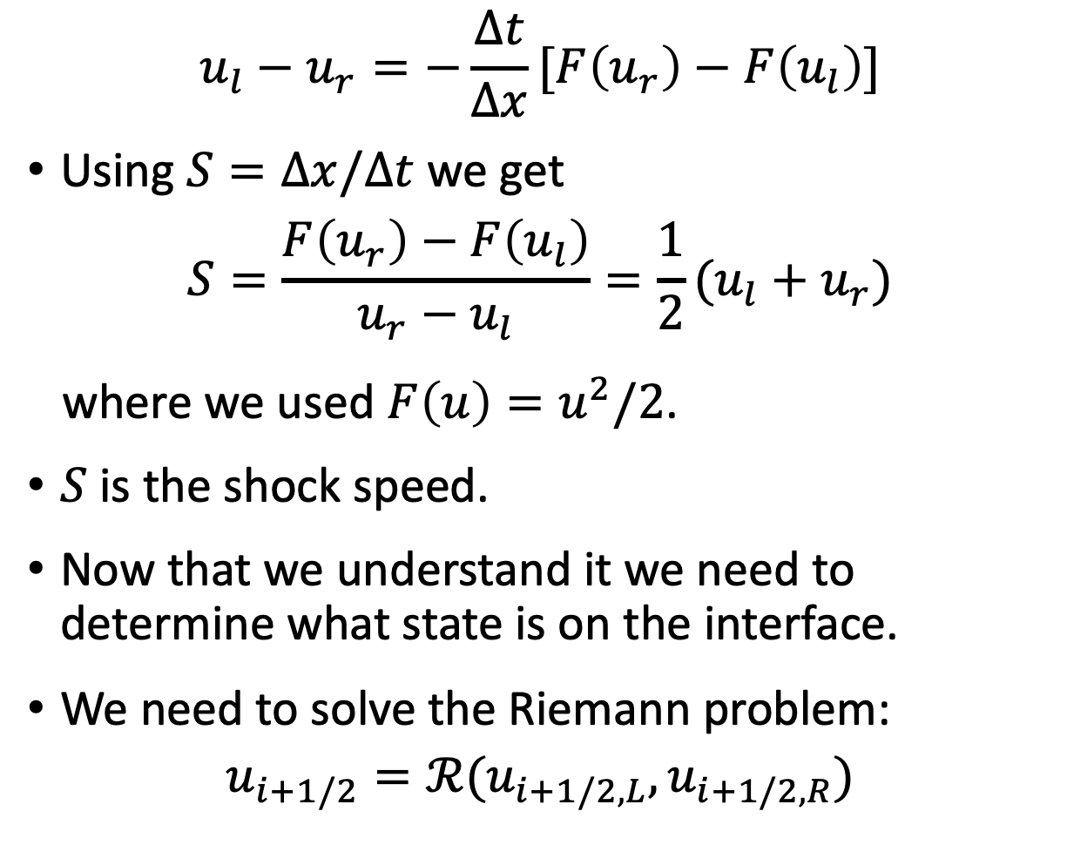
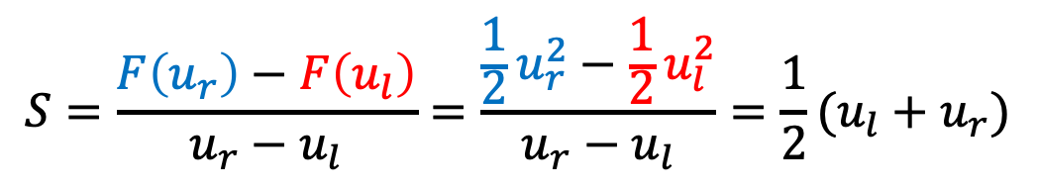
Burgers’ Riemann Problem
$$u_{l}−u_{r}=−\frac{Δt}{Δx}[F\left(u_{r}\right)−F\left(u_{l}\right)]$$
Using $S=Δx/Δt$ we get
$$S=\frac{F\left(u_{r}\right)−F\left(u_{l}\right)}{u_{r}−u_{l}}=\frac{1}{2}(u_{l}+u_{r})$$
where we used $F\left(u\right)=u^{2}/2$.
$S$ is the shock speed.
Now that we understand it we need to determine what state is on the interface.
We need to solve the Riemann problem:
$$u_{i+1/2}=ℛ(u_{i+1/2,L},u_{i+1/2,R})$$
$$S=\frac{F\left(u_{r}\right)−F\left(u_{l}\right)}{u_{r}−u_{l}}=\frac{{\frac{1}{2}u}_{r}^{2}−\frac{1}{2}u_{l}^{2}}{u_{r}−u_{l}}=\frac{1}{2}(u_{l}+u_{r})$$
$$f=f(u_{l})$$
$$f=f(u_{r})$$

Slide 11
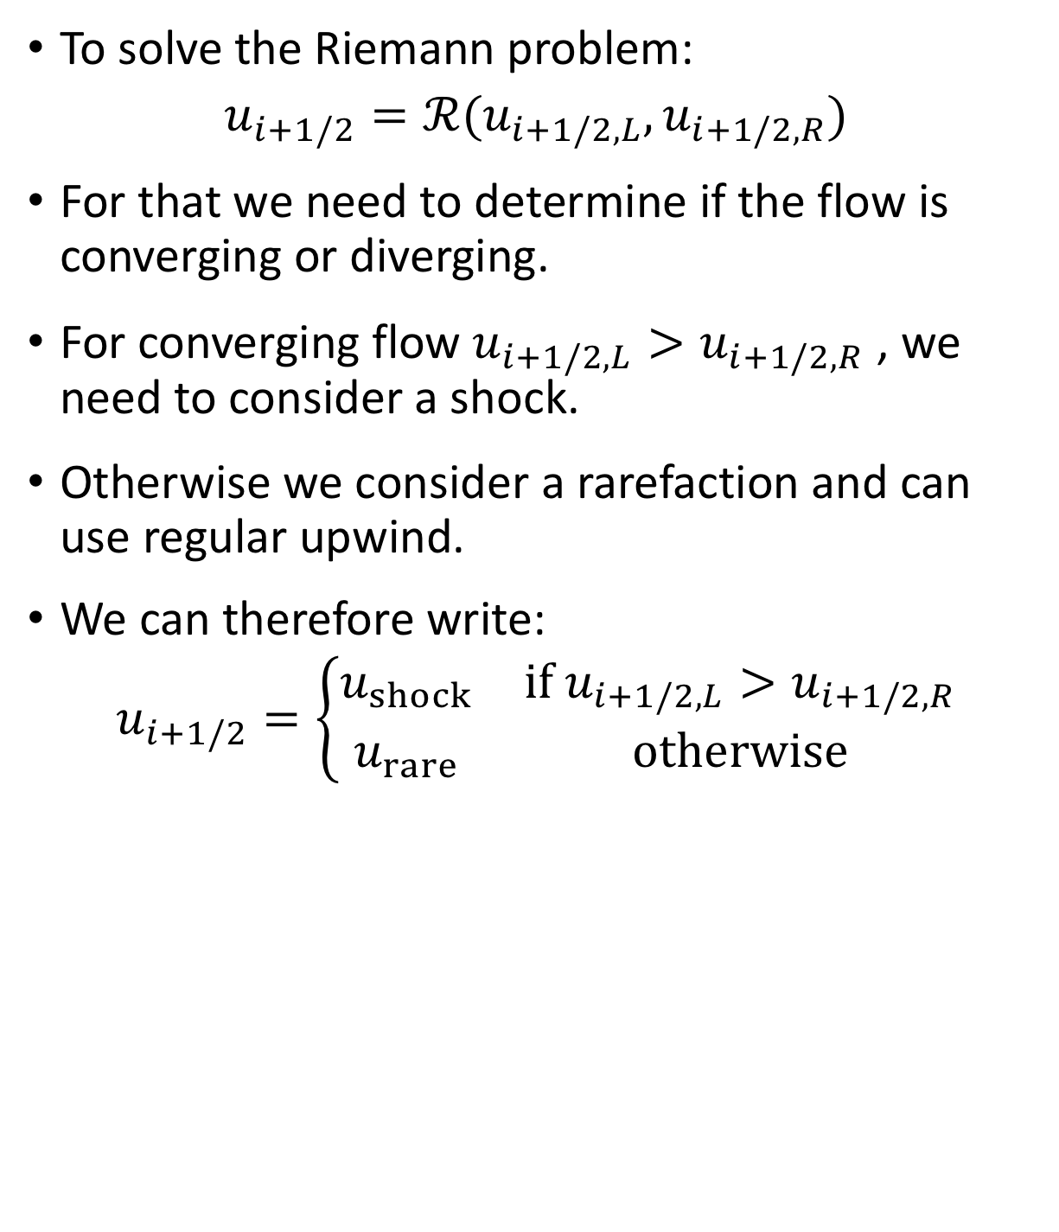
Burgers’ Riemann Problem
To solve the Riemann problem:
$$u_{i+1/2}=ℛ(u_{i+1/2,L},u_{i+1/2,R})$$
For that we need to determine if the flow is converging or diverging.
For converging flow $u_{i+1/2,L}>u_{i+1/2,R}$ , we need to consider a shock.
Otherwise we consider a rarefaction and can use regular upwind.
We can therefore write:
$$u_{i+1/2}=\left\{\begin{matrix}u_{shock} & if u_{i+1/2,L}>u_{i+1/2,R} \\ u_{rare} & otherwise\end{matrix}\right.$$
$$f=f(u_{l})$$
$$f=f(u_{r})$$

Slide 12
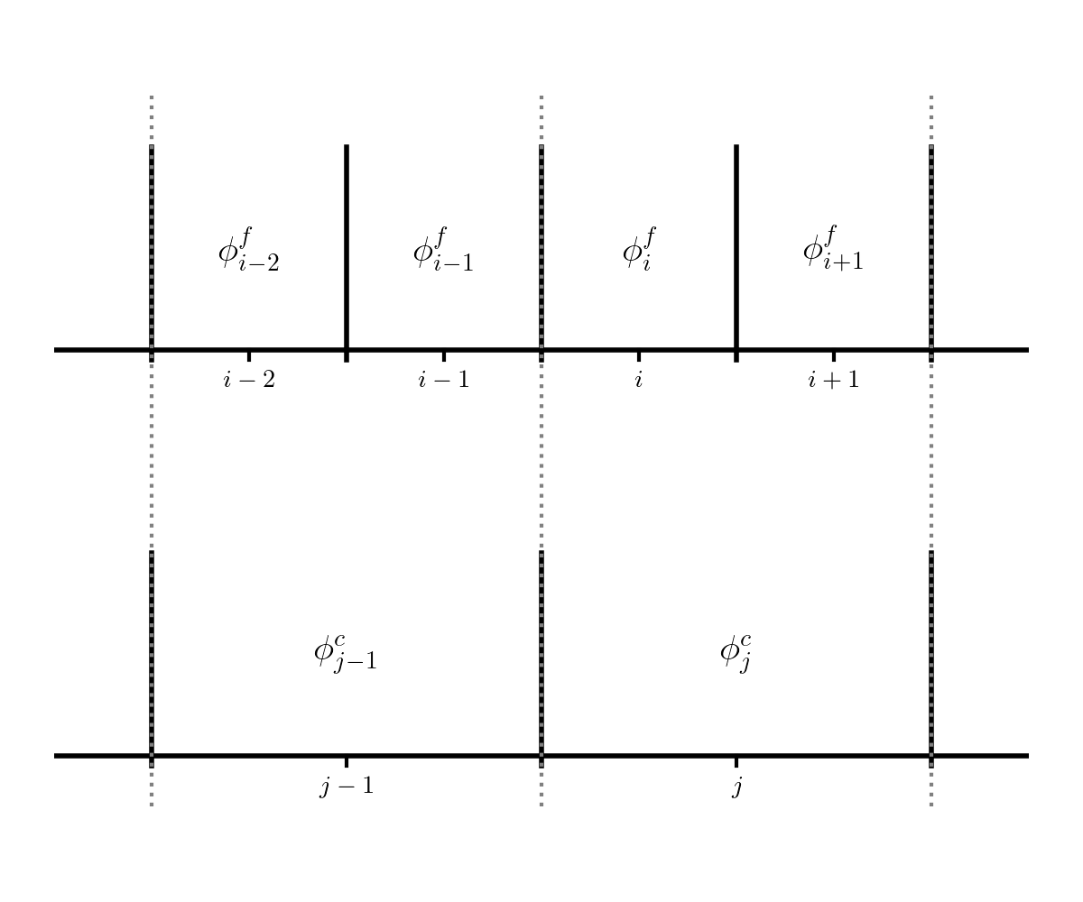

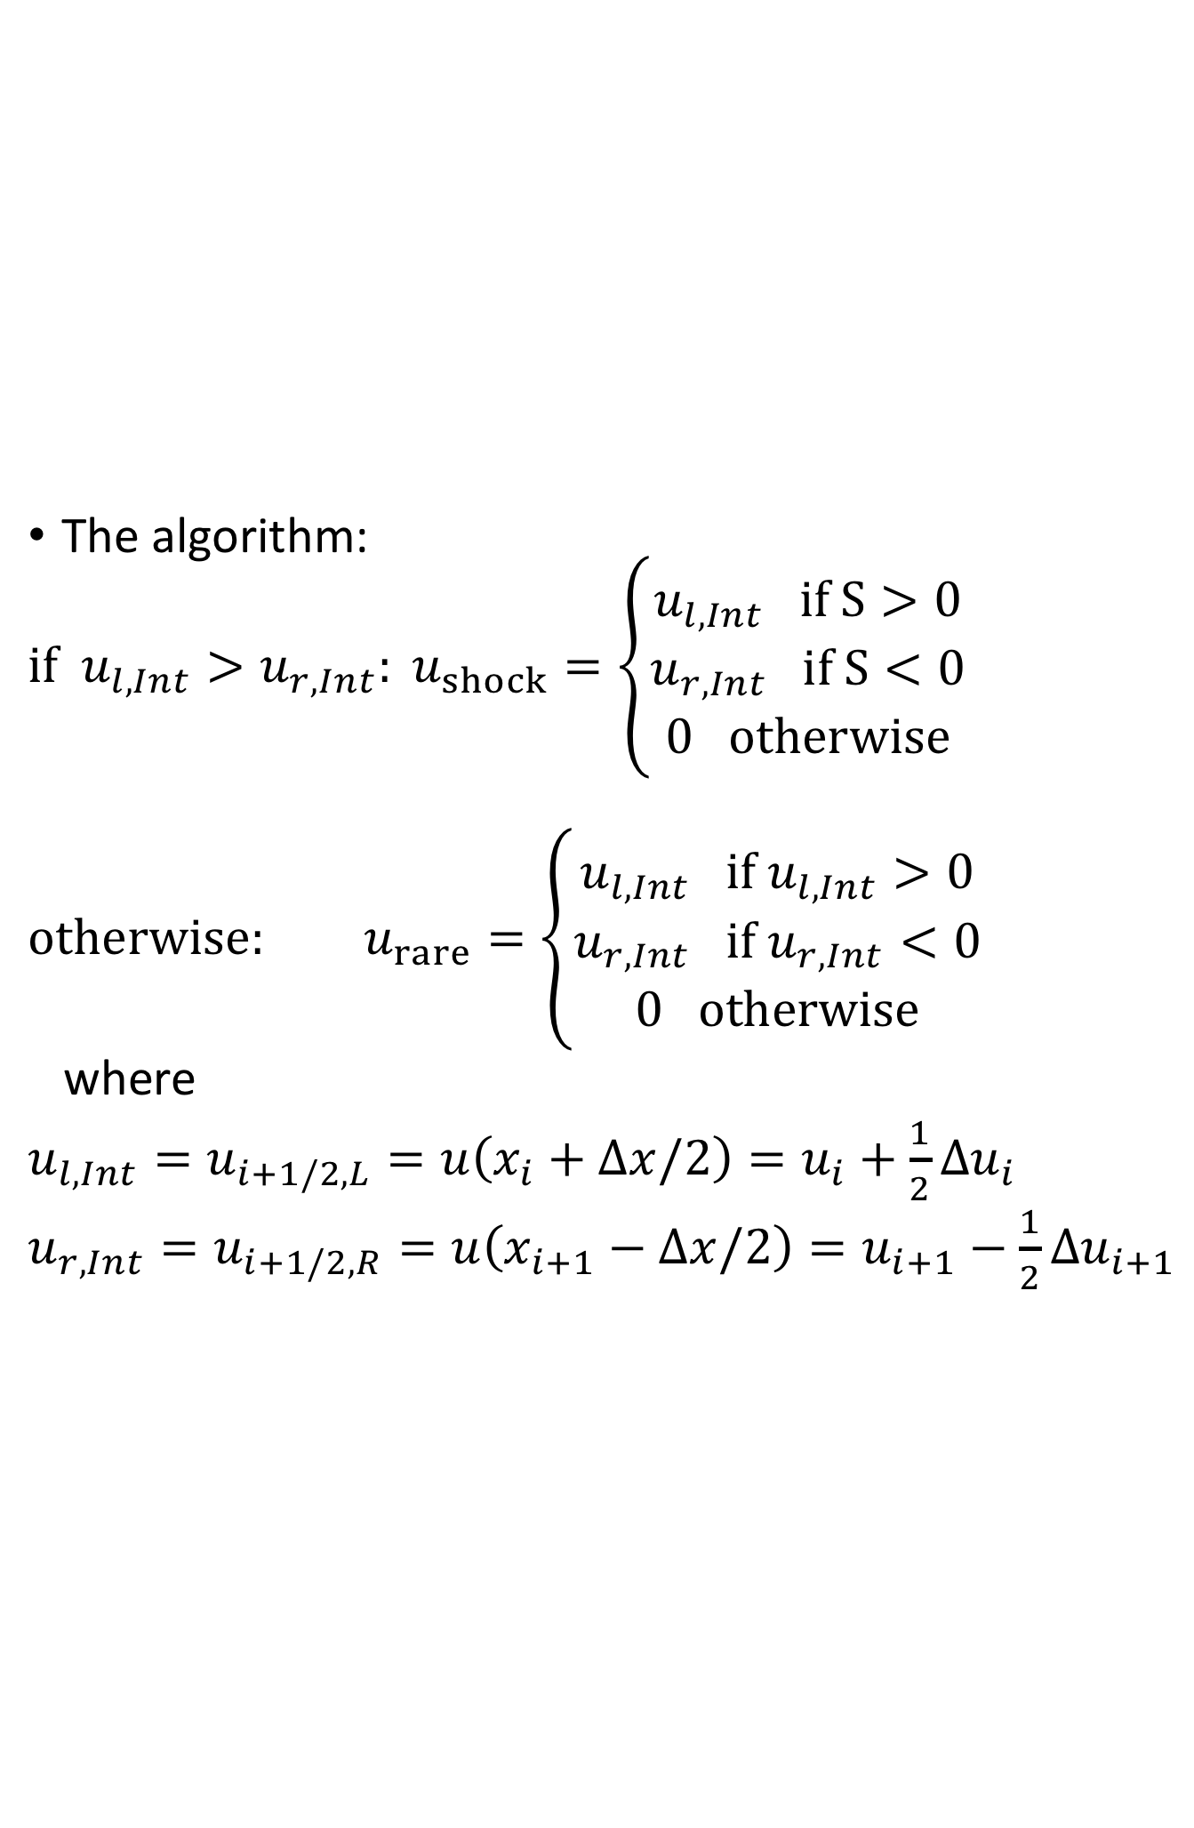



The reconstruction of states on the interfaces
The algorithm:
$if{ u}_{l,Int}>u_{r,Int}: u_{shock}=\left\{\begin{aligned}u_{l,Int} if S>0 \\ u_{r,Int} if S<0 \\ 0 otherwise\end{aligned}\right.$
$otherwise: u_{rare}=\left\{\begin{aligned}u_{l,Int} if u_{l,Int}>0 \\ u_{r,Int} if u_{r,Int}<0 \\ 0 otherwise\end{aligned}\right.$
where
${u_{l,Int}=u}_{i+1/2,L}=u\left(x_{i}+Δx/2\right)=u_{i}+\frac{1}{2}Δu_{i}$
$u_{r,Int}=u_{i+1/2,R}=u\left(x_{i+1}−Δx/2\right)=u_{i+1}−\frac{1}{2}Δu_{i+1}$
(shock)
$$u_{l, Int}$$
$$u_{r, Int}$$
(upwind)
$$i$$
$$i+1$$

Slide 13

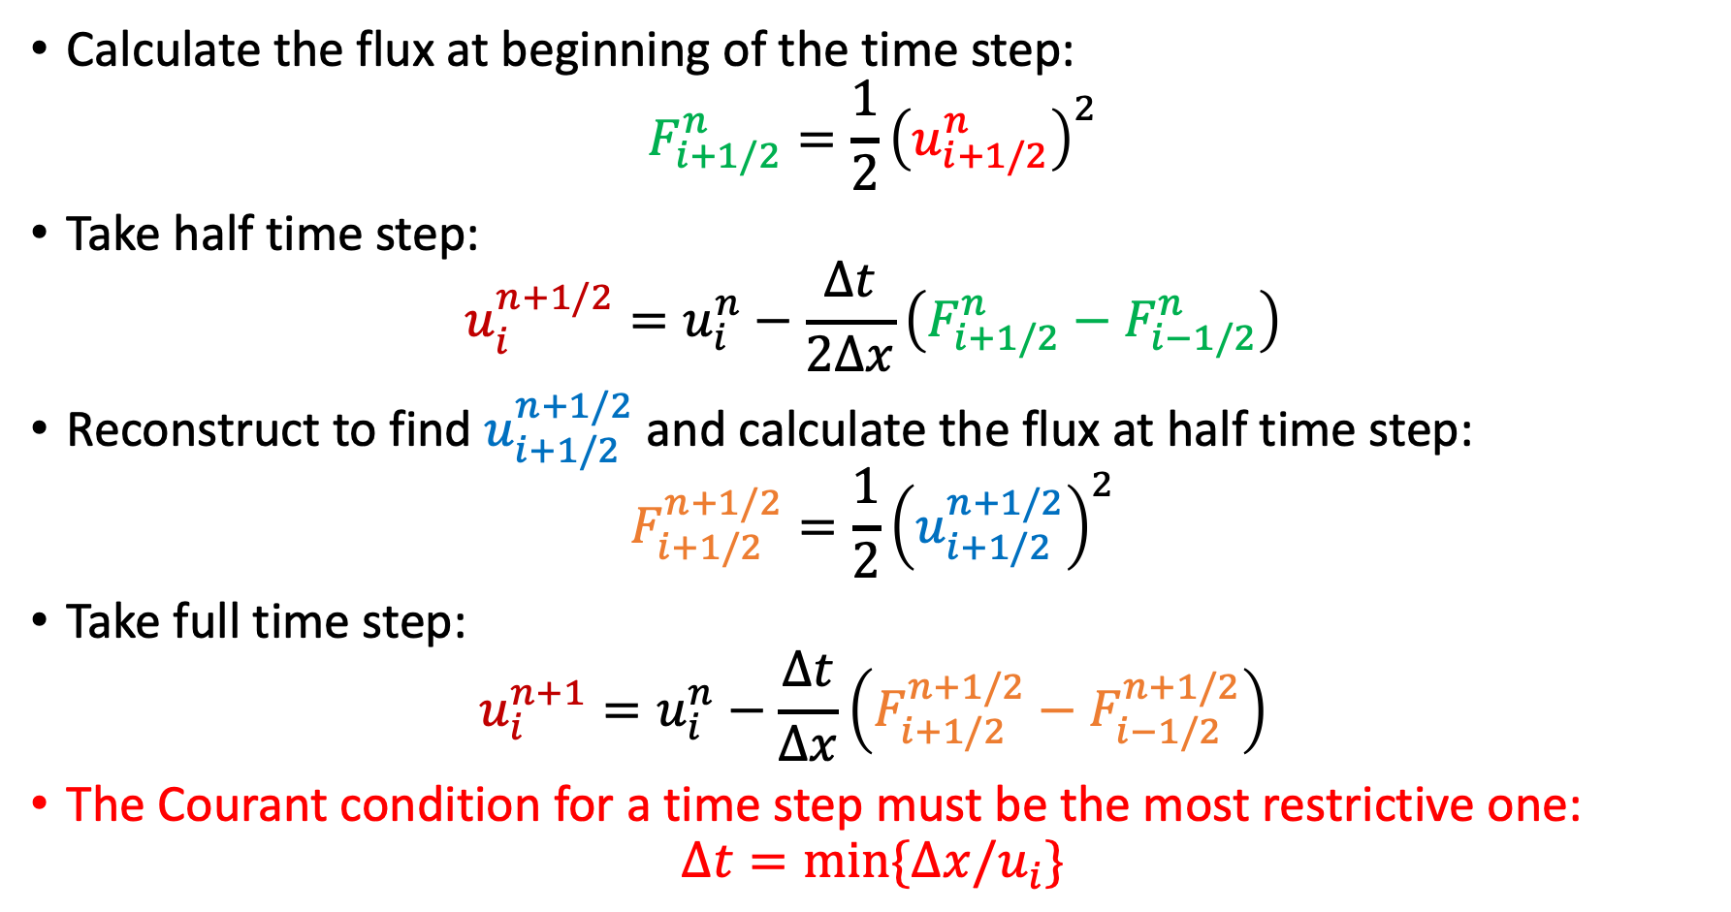
The full time step (2nd order in time)
Calculate the flux at beginning of the time step:
$$F_{i+1/2}^{n}=\frac{1}{2}{\left(u_{i+1/2}^{n}\right)}^{2}$$
Take half time step:
$$u_{i}^{n+1/2}=u_{i}^{n}−\frac{Δt}{2Δx}\left(F_{i+1/2}^{n}−F_{i−1/2}^{n}\right)$$
Reconstruct to find $u_{i+1/2}^{n+1/2}$ and calculate the flux at half time step:
$$F_{i+1/2}^{n+1/2}=\frac{1}{2}{\left(u_{i+1/2}^{n+1/2}\right)}^{2}$$
Take full time step:
$$u_{i}^{n+1}=u_{i}^{n}−\frac{Δt}{Δx}\left(F_{i+1/2}^{n+1/2}−F_{i−1/2}^{n+1/2}\right)$$
The Courant condition for a time step must be the most restrictive one:
$$Δt=\min{\{Δx/u_{i}\}}$$
$$i$$

Slide 14
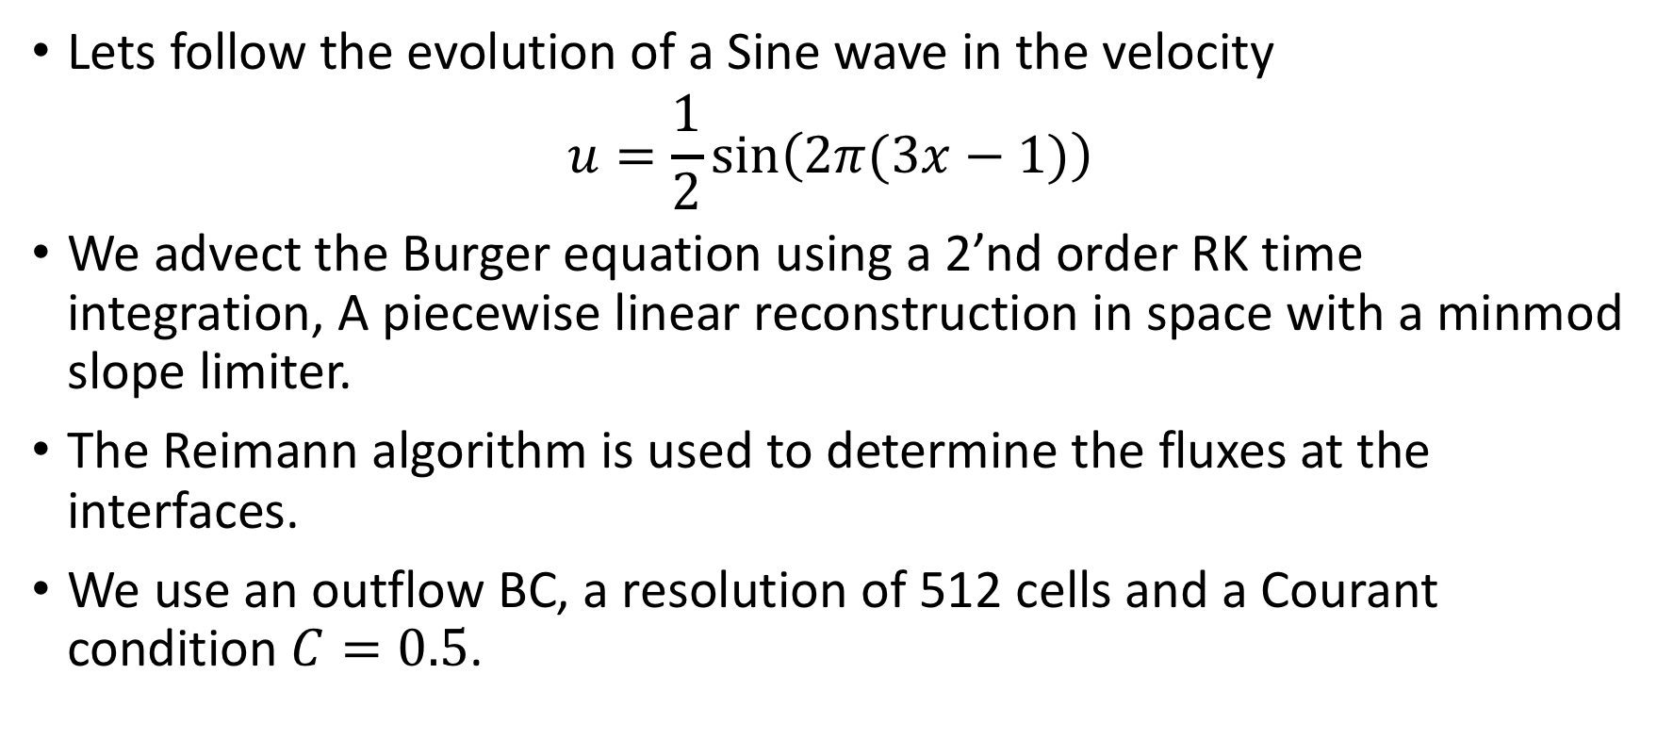

Example – steepening of a sine wave in $u$
Lets follow the evolution of a Sine wave in the velocity
$$u=\frac{1}{2}sin\left(2π(3x−1)\right)$$
We advect the Burger equation using a 2’nd order RK time integration, A piecewise linear reconstruction in space with a minmod slope limiter.
The Reimann algorithm is used to determine the fluxes at the interfaces.
We use an outflow BC, a resolution of 512 cells and a Courant condition $C=0.5$.

Slide 15
Example – steepening of a sine wave in $u$
Source code: Tutorial on computational astrophysics by M. Zingale

Slide 16
Example – steepening of a sine wave in $u$
Source code: Tutorial on computational astrophysics by M. Zingale

Slide 17
Example – steepening of a sine wave in $u$
Source code: Tutorial on computational astrophysics by M. Zingale

Slide 18
Example – steepening of a sine wave in $u$
Source code: Tutorial on computational astrophysics by M. Zingale

Slide 19
Example – steepening of a sine wave in $u$
Source code: Tutorial on computational astrophysics by M. Zingale

Slide 20
Example – steepening of a sine wave in $u$
Source code: Tutorial on computational astrophysics by M. Zingale

Slide 21
Rarefaction waves and Shock capturing
We can also simulate the formation of a rarefaction wave:
Source code: Tutorial on computational astrophysics by M. Zingale

Slide 22
Rarefaction waves and Shock capturing
We can also simulate the formation of a rarefaction wave:
Source code: Tutorial on computational astrophysics by M. Zingale

Slide 23
Rarefaction waves and Shock capturing
We can also simulate the formation of a rarefaction wave:
Source code: Tutorial on computational astrophysics by M. Zingale

Slide 24
Rarefaction waves and Shock capturing
We can also simulate the formation of a rarefaction wave:
Source code: Tutorial on computational astrophysics by M. Zingale

Slide 25
Rarefaction waves and Shock capturing
We can also simulate the formation of a rarefaction wave:
Source code: Tutorial on computational astrophysics by M. Zingale

Slide 26
Rarefaction waves and Shock capturing
Or follow the evolution of shocks
Source code: Tutorial on computational astrophysics by M. Zingale

Slide 27
Rarefaction waves and Shock capturing
Or follow the evolution of shocks
Source code: Tutorial on computational astrophysics by M. Zingale

Slide 28
Rarefaction waves and Shock capturing
Or follow the evolution of shocks
Source code: Tutorial on computational astrophysics by M. Zingale

Slide 29
Rarefaction waves and Shock capturing
Or follow the evolution of shocks
Source code: Tutorial on computational astrophysics by M. Zingale

Slide 30
Rarefaction waves and Shock capturing
Or follow the evolution of shocks
Source code: Tutorial on computational astrophysics by M. Zingale

Slide 31
Lecture 8 - Elliptic Equations and Multigrid
Omer Bromberg
omerbr@tauex.tau.ac.il
Winter 2025/6
Modified from lecture notes by Michael Zingale & Cyrus Dreyer

Slide 32
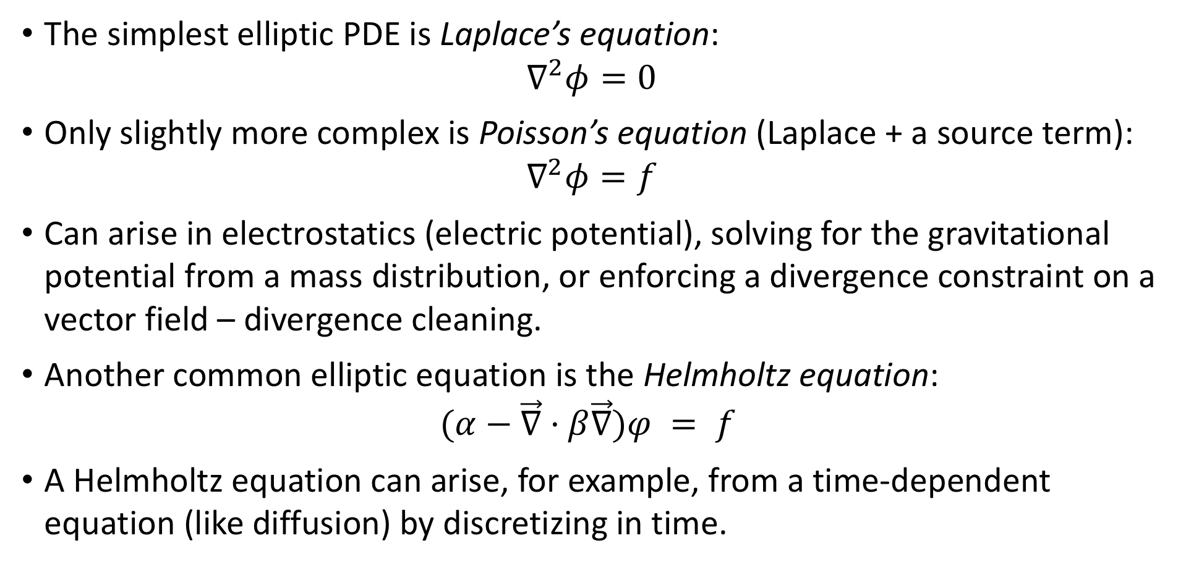
Elliptic Equations and Multigrid
The simplest elliptic PDE is Laplace’s equation:
$$∇^{2}φ=0$$
Only slightly more complex is Poisson’s equation (Laplace + a source term):
$$∇^{2}φ=f$$
Can arise in electrostatics (electric potential), solving for the gravitational potential from a mass distribution, or enforcing a divergence constraint on a vector field – divergence cleaning.
Another common elliptic equation is the Helmholtz equation: $(α−\vec{∇}·β\vec{∇})φ = f$
A Helmholtz equation can arise, for example, from a time-dependent equation (like diffusion) by discretizing in time.

Slide 33

Elliptic Equations and Multigrid
No time-dependencies in any of these equations.
The quantity $φ$ is specified instantaneously in the domain subject to boundary conditions.
This makes the solution methods very different then what we saw for hyperbolic problems.

Slide 34






Boundary conditions
Elliptic equations are boundary value problems.
The solution of the equations requires setting boundary conditions.
Boundary condition
needed here
$$L_{y}$$
Solution determined in this
region of parameter space
Boundary condition
needed here
Boundary condition
needed here
$$y$$
$$0$$
$$0$$
$$x$$
$$L_{x}$$
Boundary condition
needed here

Slide 35


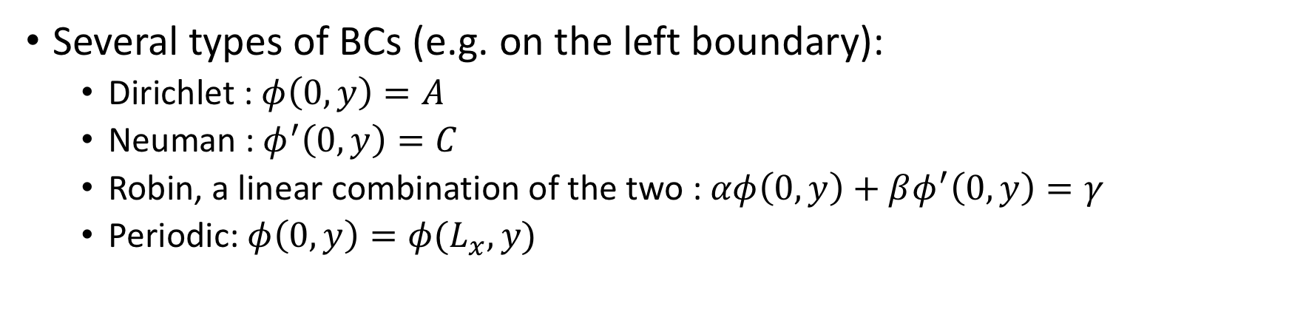



Boundary conditions
Several types of BCs (e.g. on the left boundary):
Dirichlet : $φ\left(0, y\right)=A$
Neuman : $φ^{′}\left(0, y\right)=C$
Robin, a linear combination of the two : $αφ\left(0, y\right)+βφ^{′}\left(0, y\right)=γ$
Periodic: $φ\left(0,y\right)=φ(L_{x},y)$
$$L_{y}$$
Solution determined in this
region of parameter space
$$y$$
$$0$$
$$0$$
$$x$$
$$L_{x}$$

Slide 36
Boundary conditions
We can have different BCs on each boundary
If the values are set to zero the BCs are called homogeneous, otherwise they are called inhomogeneous.
$$L_{y}$$
Solution determined in this
region of parameter space
$$y$$
$$0$$
$$0$$
$$x$$
$$L_{x}$$

Slide 37
Solution methods
There are several methods to solve elliptic PDE
Fourier Method : Requires conducting a Fourier transform. Works only for periodic boundary conditions (See M. Zingale book).
Relaxation Method : An iterative method, requires an initial guess and (slowly) converges to the solution. Also provides the basis for the multigrid technique.

Slide 38
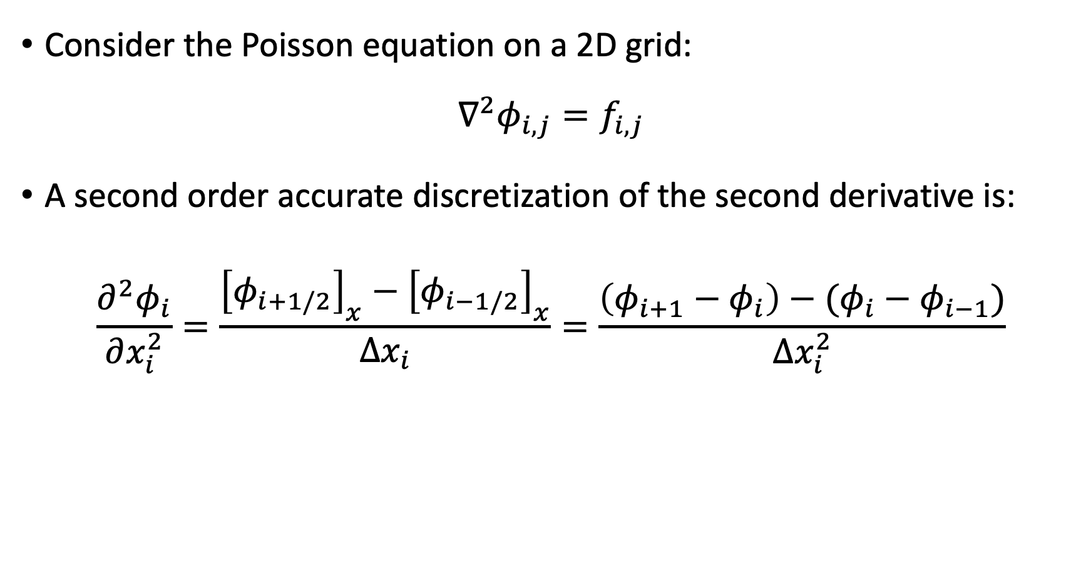
The relaxation method for the Poisson problem:
Consider the Poisson equation on a 2D grid:
$$∇^{2}φ_{i,j}=f_{i,j}$$
A second order accurate discretization of the second derivative is:
$$\frac{∂^{2}φ_{i}}{∂x_{i}^{2}}=\frac{{\left[φ_{i+1/2}\right]}_{x}−{\left[φ_{i−1/2}\right]}_{x}}{Δx_{i}}=\frac{\left(φ_{i+1}−φ_{i}\right)−(φ_{i}−φ_{i−1})}{Δx_{i}^{2}}$$
Notes:
D^2P / Dx^2 = (Dp/Dx(i+1/2) - Dp/Dx(i-1/2)) / Dx = D

Slide 39
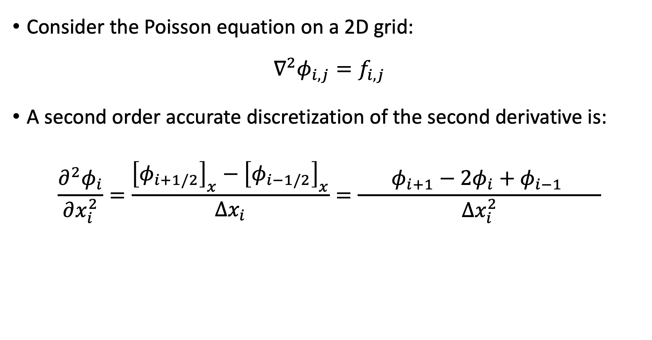
The relaxation method for the Poisson problem:
Consider the Poisson equation on a 2D grid:
$$∇^{2}φ_{i,j}=f_{i,j}$$
A second order accurate discretization of the second derivative is:
$$\frac{∂^{2}φ_{i}}{∂x_{i}^{2}}=\frac{{\left[φ_{i+1/2}\right]}_{x}−{\left[φ_{i−1/2}\right]}_{x}}{Δx_{i}}=\frac{ φ_{i+1}−2φ_{i}+φ_{i−1} }{Δx_{i}^{2}}$$
Notes:
D^2P / Dx^2 = (Dp/Dx(i+1/2) - Dp/Dx(i-1/2)) / Dx = D

Slide 40
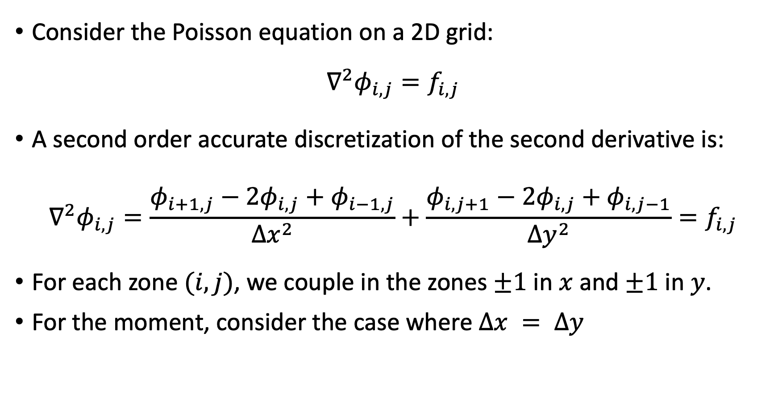
The relaxation method for the Poisson problem:
Consider the Poisson equation on a 2D grid:
$$∇^{2}φ_{i,j}=f_{i,j}$$
A second order accurate discretization of the second derivative is:
$$∇^{2}φ_{i,j}=\frac{φ_{i+1,j}−2φ_{i,j}+φ_{i−1,j}}{Δx^{2}}+\frac{φ_{i,j+1}−2φ_{i,j}+φ_{i,j−1}}{Δy^{2}}=f_{i,j}$$
For each zone $(i, j)$, we couple in the zones $±1$ in $x$ and $±1$ in $y$.
For the moment, consider the case where $∆x = ∆y$
Notes:
D^2P / Dx^2 = (Dp/Dx(i+1/2) - Dp/Dx(i-1/2)) / Dx = D

Slide 41
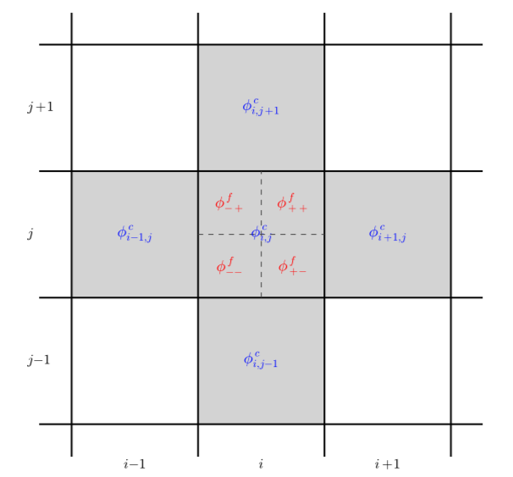











$$j+1$$
$$φ_{i,j+1}$$
$$j$$
$$φ_{i−1,j}$$
$$φ_{i,j}$$
$$φ_{i+1,j}$$
$$j−1$$
$$φ_{i,j−1}$$
$$i−1$$
$$i$$
$$i+1$$

Slide 42
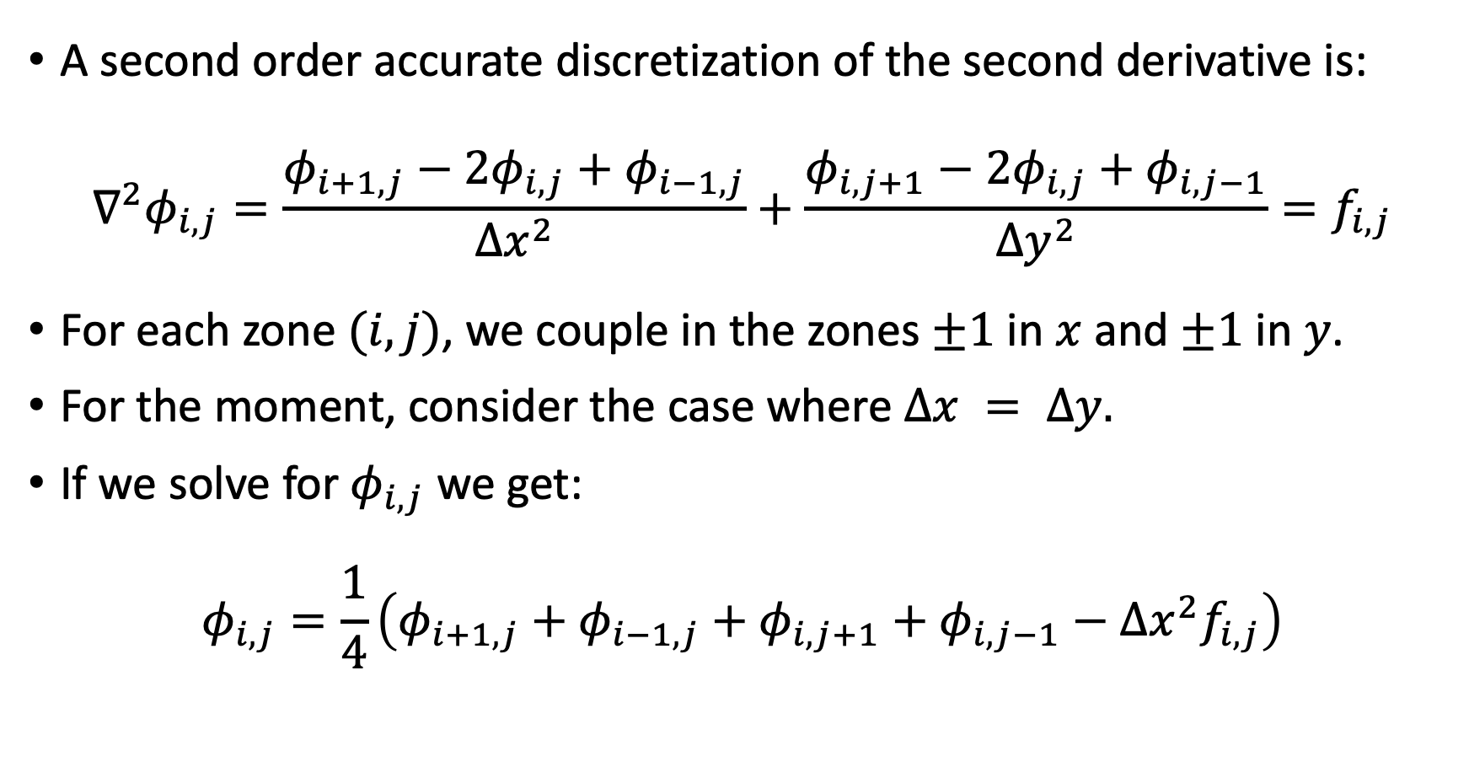
The relaxation method for the Poisson problem:
A second order accurate discretization of the second derivative is:
$$∇^{2}φ_{i,j}=\frac{φ_{i+1,j}−2φ_{i,j}+φ_{i−1,j}}{Δx^{2}}+\frac{φ_{i,j+1}−2φ_{i,j}+φ_{i,j−1}}{Δy^{2}}=f_{i,j}$$
For each zone $(i, j)$, we couple in the zones $±1$ in $x$ and $±1$ in $y$.
For the moment, consider the case where $∆x = ∆y.$
If we solve for $φ_{i,j}$ we get:
$$φ_{i,j}=\frac{1}{4}\left(φ_{i+1,j}+φ_{i−1,j}+φ_{i,j+1}+φ_{i,j−1}−Δx^{2}f_{i,j}\right)$$

Slide 43
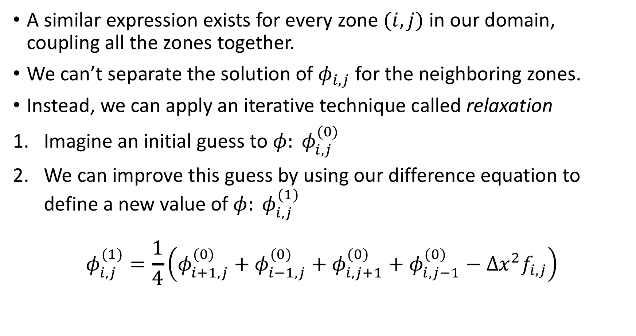
The relaxation method for the Poisson problem:
A similar expression exists for every zone $(i, j)$ in our domain, coupling all the zones together.
We can’t separate the solution of $φ_{i,j}$ for the neighboring zones.
Instead, we can apply an iterative technique called relaxation
Imagine an initial guess to $φ: φ_{i,j}^{(0)}$
We can improve this guess by using our difference equation to define a new value of $φ: φ_{i,j}^{(1)}$
$$φ_{i,j}^{(1)}=\frac{1}{4}\left(φ_{i+1,j}^{(0)}+φ_{i−1,j}^{(0)}+φ_{i,j+1}^{(0)}+φ_{i,j−1}^{(0)}−Δx^{2}f_{i,j}\right)$$

Slide 44
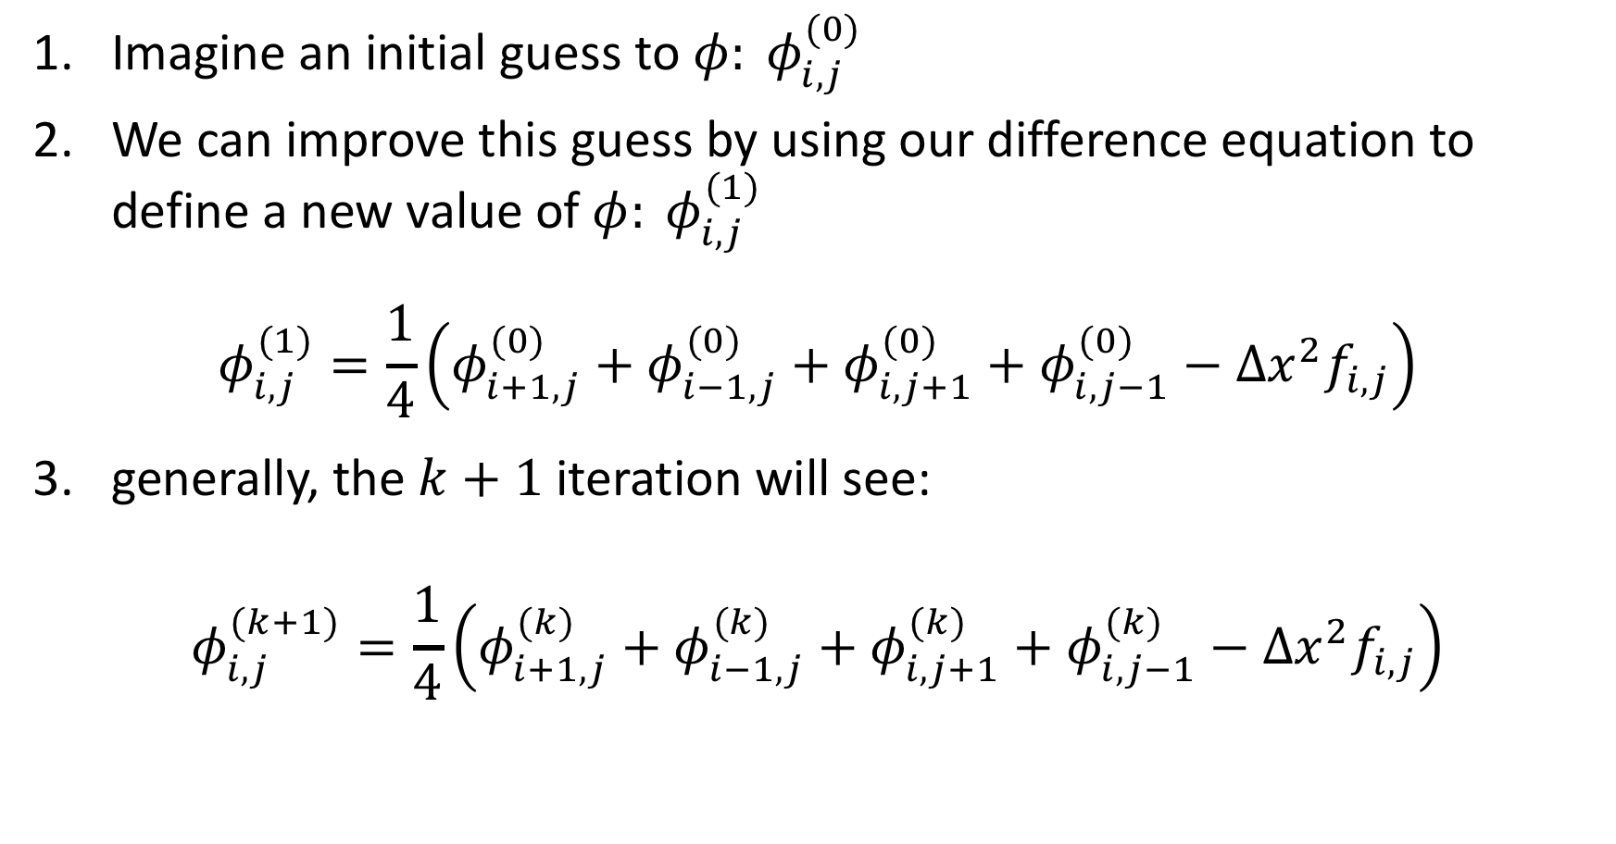
The relaxation method for the Poisson problem:
Imagine an initial guess to $φ: φ_{i,j}^{(0)}$
We can improve this guess by using our difference equation to define a new value of $φ: φ_{i,j}^{(1)}$
$$φ_{i,j}^{(1)}=\frac{1}{4}\left(φ_{i+1,j}^{(0)}+φ_{i−1,j}^{(0)}+φ_{i,j+1}^{(0)}+φ_{i,j−1}^{(0)}−Δx^{2}f_{i,j}\right)$$
generally, the $k+1$iteration will see:
$$φ_{i,j}^{(k+1)}=\frac{1}{4}\left(φ_{i+1,j}^{(k)}+φ_{i−1,j}^{(k)}+φ_{i,j+1}^{(k)}+φ_{i,j−1}^{(k)}−Δx^{2}f_{i,j}\right)$$

Slide 45
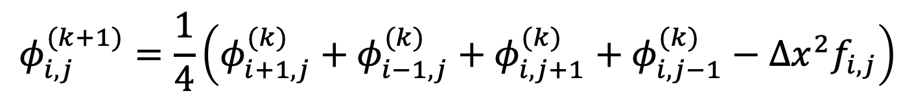
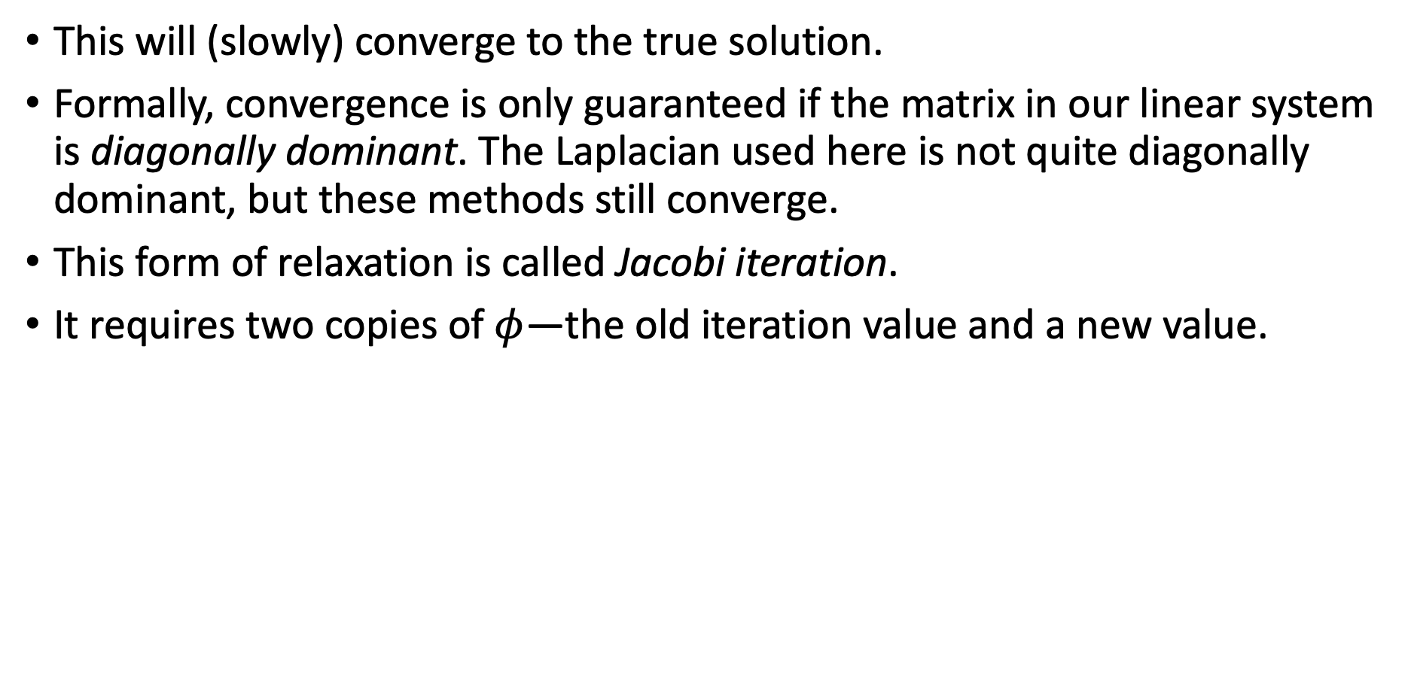
The relaxation method for the Poisson problem:
This will (slowly) converge to the true solution.
Formally, convergence is only guaranteed if the matrix in our linear system is diagonally dominant. The Laplacian used here is not quite diagonally dominant, but these methods still converge.
This form of relaxation is called Jacobi iteration.
It requires two copies of $φ$—the old iteration value and a new value.
$$φ_{i,j}^{(k+1)}=\frac{1}{4}\left(φ_{i+1,j}^{(k)}+φ_{i−1,j}^{(k)}+φ_{i,j+1}^{(k)}+φ_{i,j−1}^{(k)}−Δx^{2}f_{i,j}\right)$$

Slide 46
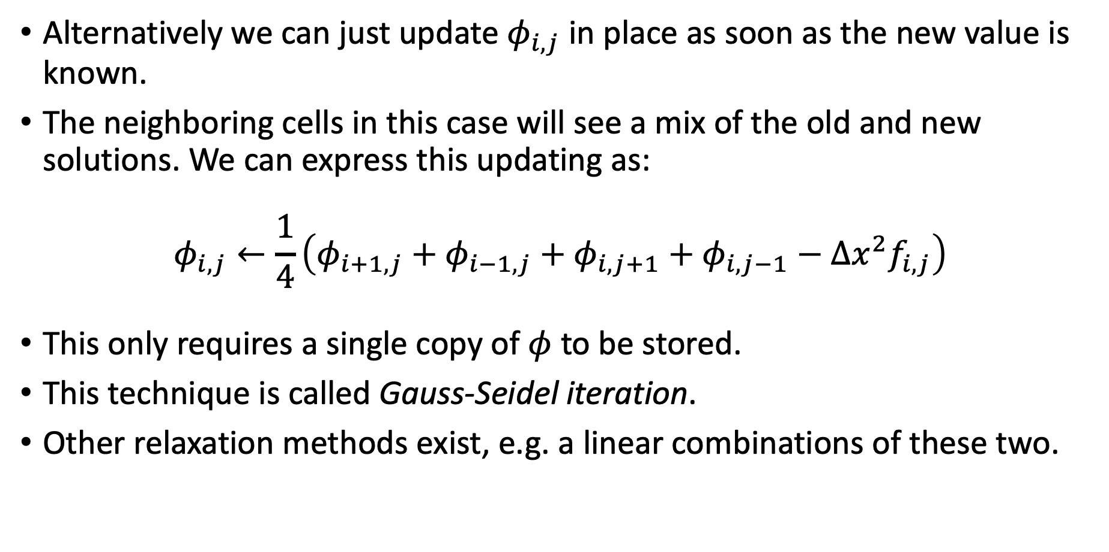
The relaxation method for the Poisson problem:
Alternatively we can just update $φ_{i,j}$ in place as soon as the new value is known.
The neighboring cells in this case will see a mix of the old and new solutions. We can express this updating as:
$$φ_{i,j}←\frac{1}{4}\left(φ_{i+1,j}+φ_{i−1,j}+φ_{i,j+1}+φ_{i,j−1}−Δx^{2}f_{i,j}\right)$$
This only requires a single copy of $φ$ to be stored.
This technique is called Gauss-Seidel iteration.
Other relaxation methods exist, e.g. a linear combinations of these two.

Slide 47

Boundary conditions
Set the function value on the boundaries of the domain: $φ_{lo}, φ_{hi}$.
When using face-centered grid, the function values are given on the boundaries.
When using a cell-centered grid, no points fall exactly on the boundary, so ghost cells are needed to specify boundary conditions.
A single ghost cell is sufficient for the 5-point stencil used here.

Slide 48
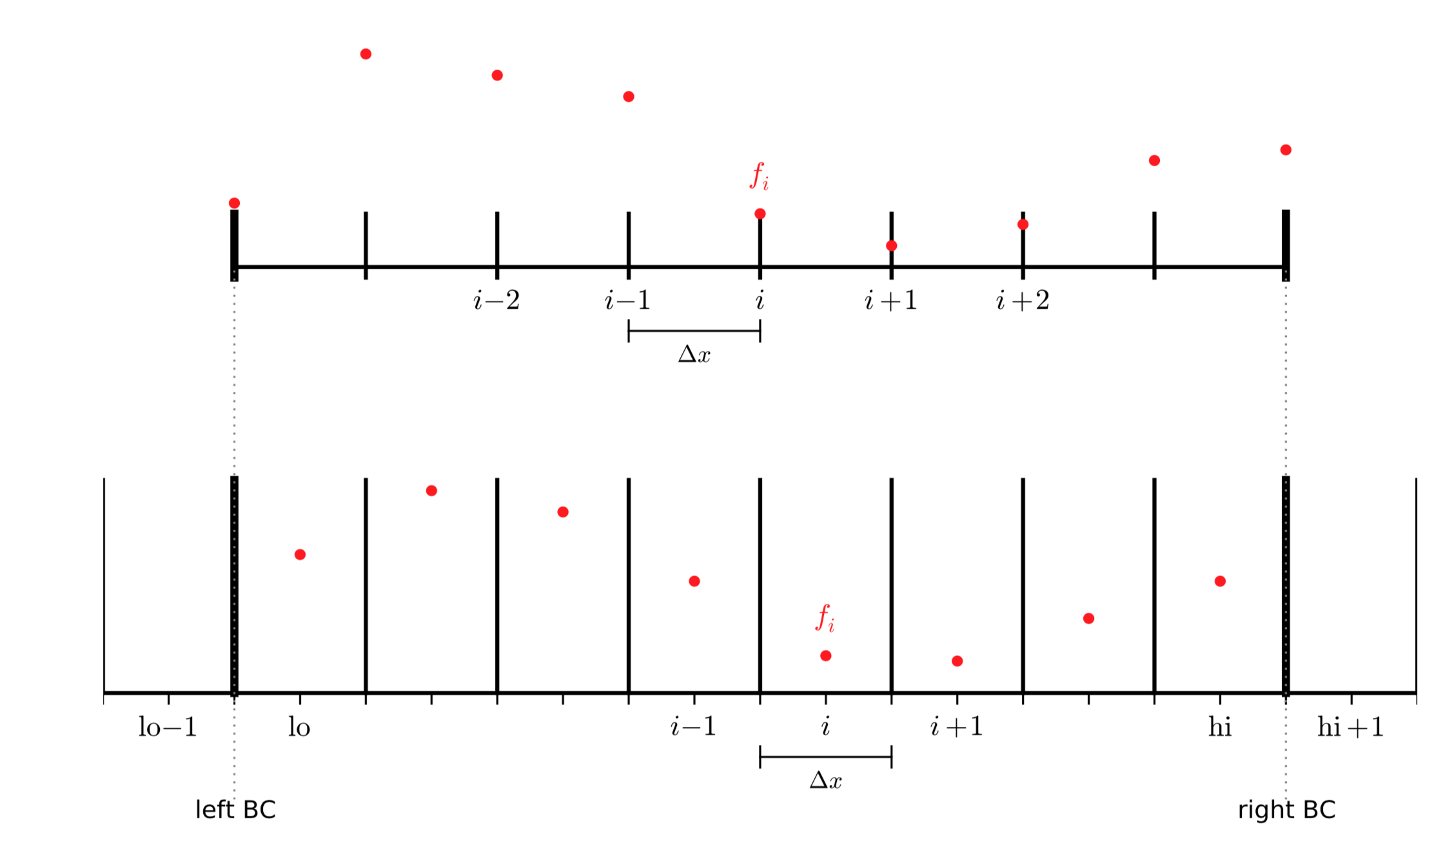
Boundary conditions
Face centered
grid
lo
hi
Cell centered
grid

Slide 49
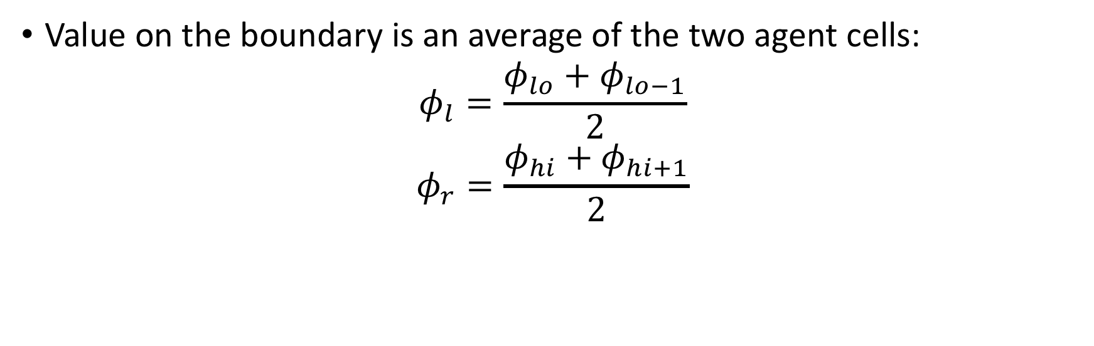
Boundary conditions : Dirichlet
Value on the boundary is an average of the two agent cells:
$$φ_{l}=\frac{φ_{lo}+φ_{lo−1}}{2}$$
$$φ_{r}=\frac{φ_{hi}+φ_{hi+1}}{2}$$
Cell centered
grid

Slide 50
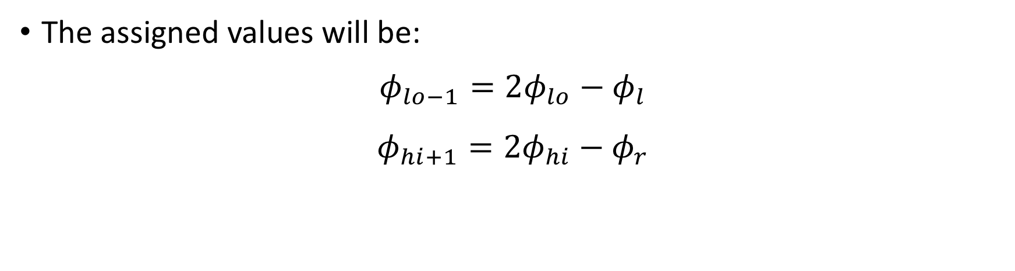
Boundary conditions : Dirichlet
The assigned values will be:
$$φ_{lo−1}={2φ}_{lo}−φ_{l}$$
$$φ_{hi+1}={2φ}_{hi}−φ_{r}$$
Cell centered
grid

Slide 51
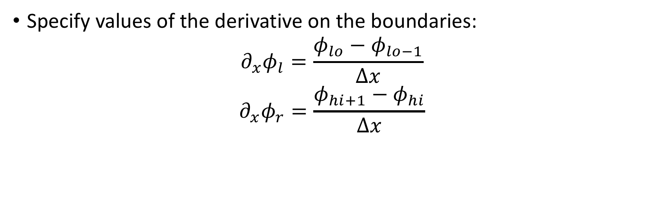
Boundary conditions : Neumann
Specify values of the derivative on the boundaries:
$${∂_{x}φ}_{l}=\frac{φ_{lo}−φ_{lo−1}}{Δx}$$
$$∂_{x}φ_{r}=\frac{{φ_{hi+1}−φ}_{hi}}{Δx}$$
Cell centered
grid

Slide 52
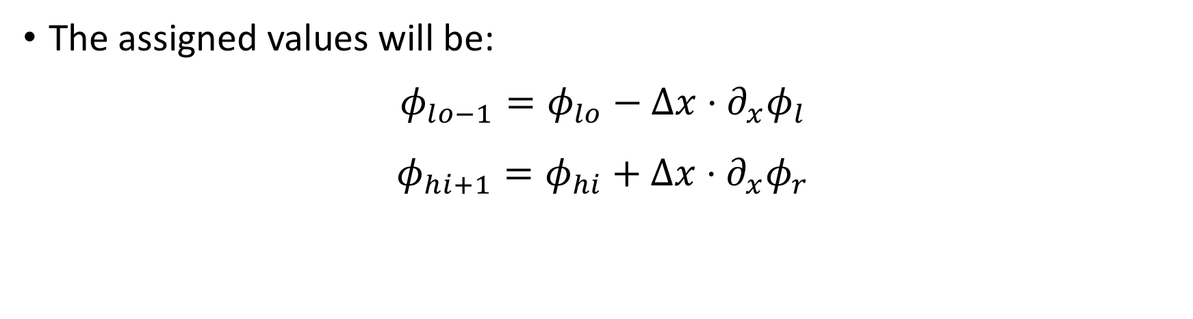
Boundary conditions : Neumann
The assigned values will be:
$$φ_{lo−1}=φ_{lo}−{{Δx⋅∂}_{x}φ}_{l}$$
$$φ_{hi+1}=φ_{hi}+{{Δx⋅∂}_{x}φ}_{r}$$
Cell centered
grid

Slide 53
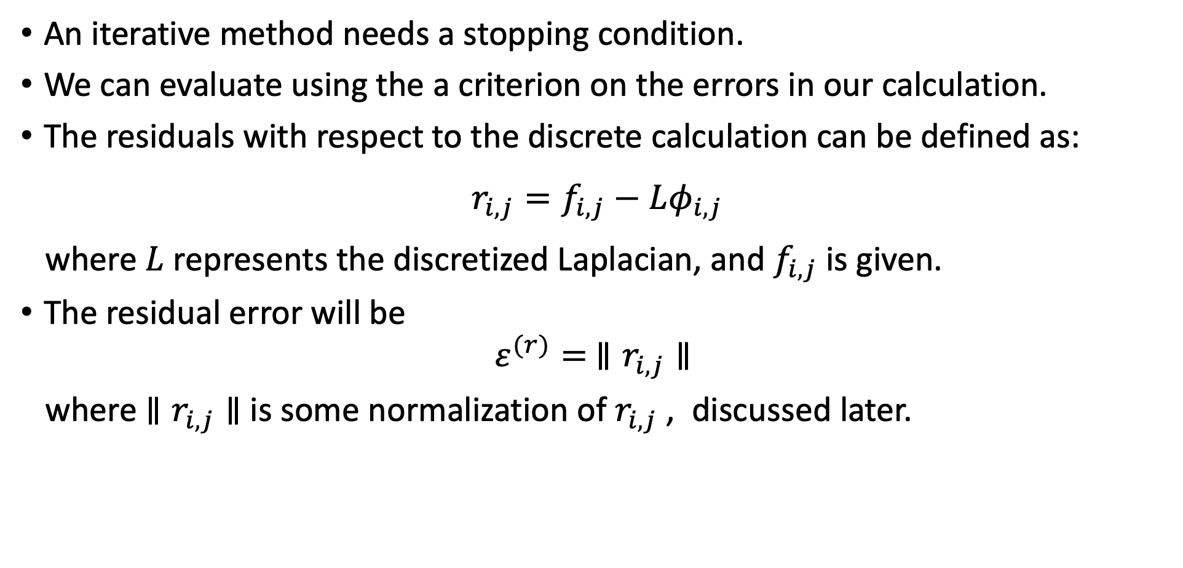
Residuals and errors
An iterative method needs a stopping condition.
We can evaluate using the a criterion on the errors in our calculation.
The residuals with respect to the discrete calculation can be defined as:
$$r_{i,j}=f_{i,j}−Lφ_{i,j}$$
where $L$ represents the discretized Laplacian, and $f_{i,j}$ is given.
The residual error will be
$$ε^{(r)}= ∥r_{i,j}∥$$
where $∥r_{i,j}∥$ is some normalization of $r_{i,j}$ , discussed later.

Slide 54
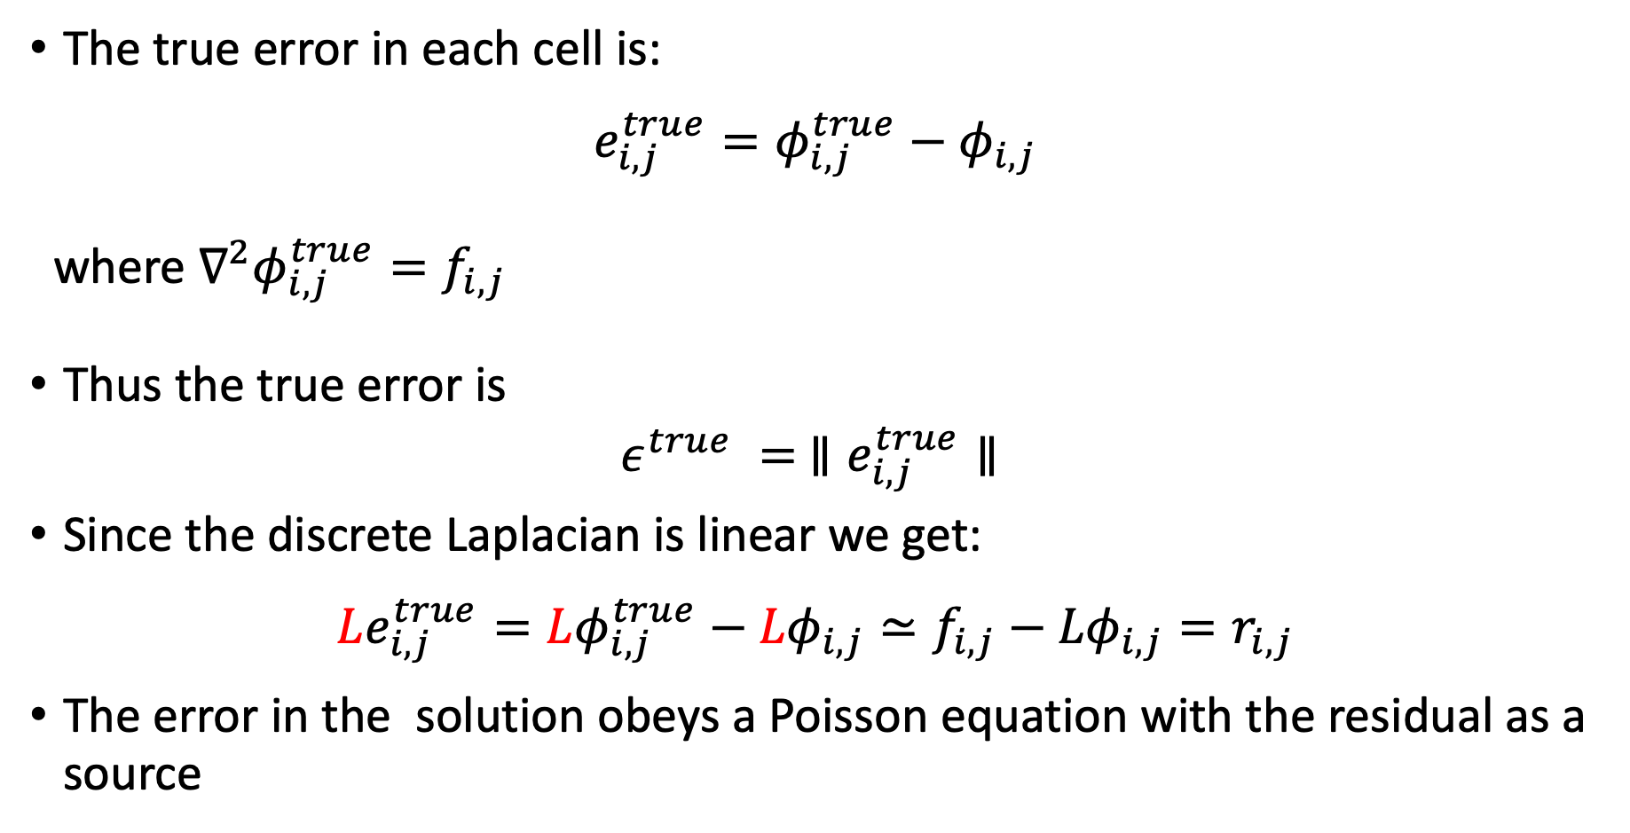
Residuals and errors
The true error in each cell is:
$$e_{i,j}^{true}=φ_{i,j}^{true}−φ_{i,j}$$
where $∇^{2}φ_{i,j}^{true}=f_{i,j}$
Thus the true error is
$$ε^{true} = ∥e_{i,j}^{true}∥$$
Since the discrete Laplacian is linear we get:
$$Le_{i,j}^{true}=Lφ_{i,j}^{true}−{Lφ}_{i,j}≃f_{i,j}−{Lφ}_{i,j}{=r}_{i,j}$$
The error in the solution obeys a Poisson equation with the residual as a source
Notes:
If we will solve this equation we will get the true error.

Slide 55
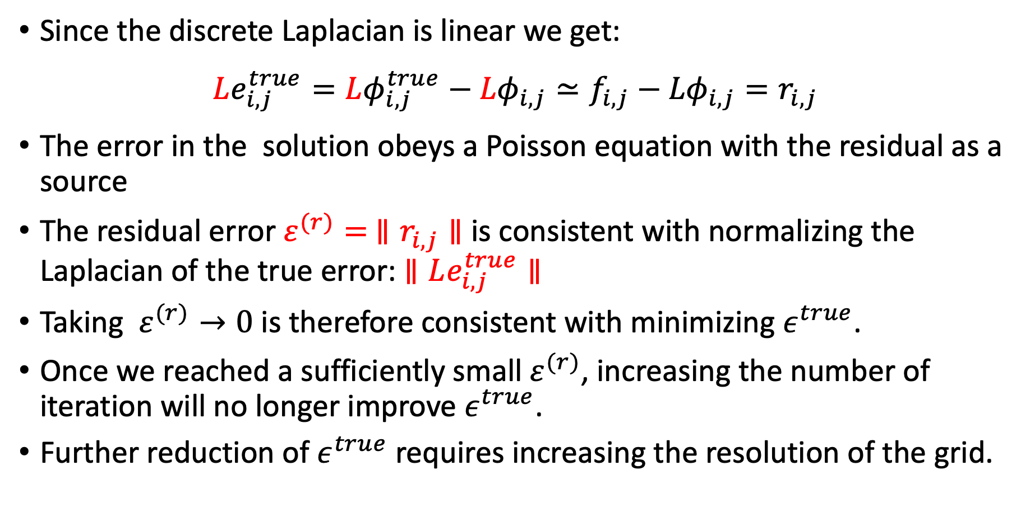
Residuals and errors
Since the discrete Laplacian is linear we get:
$$Le_{i,j}^{true}=Lφ_{i,j}^{true}−{Lφ}_{i,j}≃f_{i,j}−{Lφ}_{i,j}{=r}_{i,j}$$
The error in the solution obeys a Poisson equation with the residual as a source
The residual error $ε^{(r)}= ∥r_{i,j}∥$ is consistent with normalizing the Laplacian of the true error: $∥Le_{i,j}^{true}∥$
Taking $ε^{(r)}→0$ is therefore consistent with minimizing $ε^{true}$.
Once we reached a sufficiently small $ε^{(r)}$, increasing the number of iteration will no longer improve $ε^{true}$.
Further reduction of $ε^{true}$ requires increasing the resolution of the grid.

Slide 56
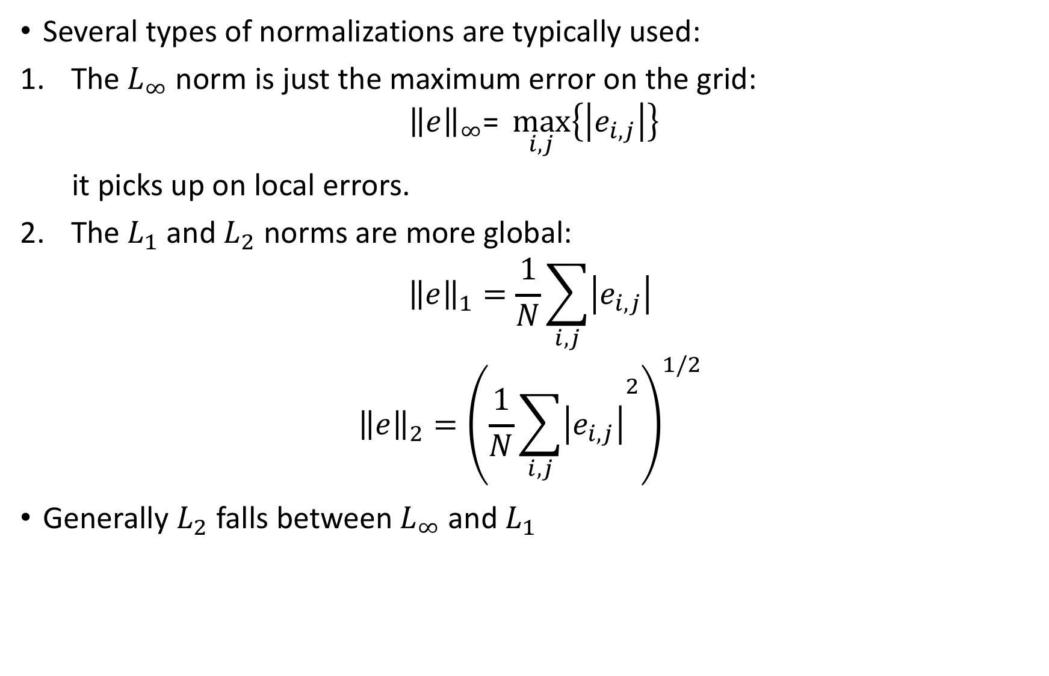
Normalizations
Several types of normalizations are typically used:
The $L_{∞}$ norm is just the maximum error on the grid:
$${\left\|e\right\|}_{∞}\text{= }\max_{i,j}\left\{\left|e_{i,j}\right|\right\}$$
it picks up on local errors.
The $L_{1}$and $L_{2}$ norms are more global:
$${\left\|e\right\|}_{1}=\frac{1}{N}\sum_{i,j}{\left|e_{i,j}\right|}$$
$${\left\|e\right\|}_{2}={\left(\frac{1}{N}{\sum_{i,j}{\left|e_{i,j}\right|}}^{2}\right)}^{1/2}$$
Generally $L_{2}$ falls between $L_{∞}$ and $L_{1}$

Slide 57
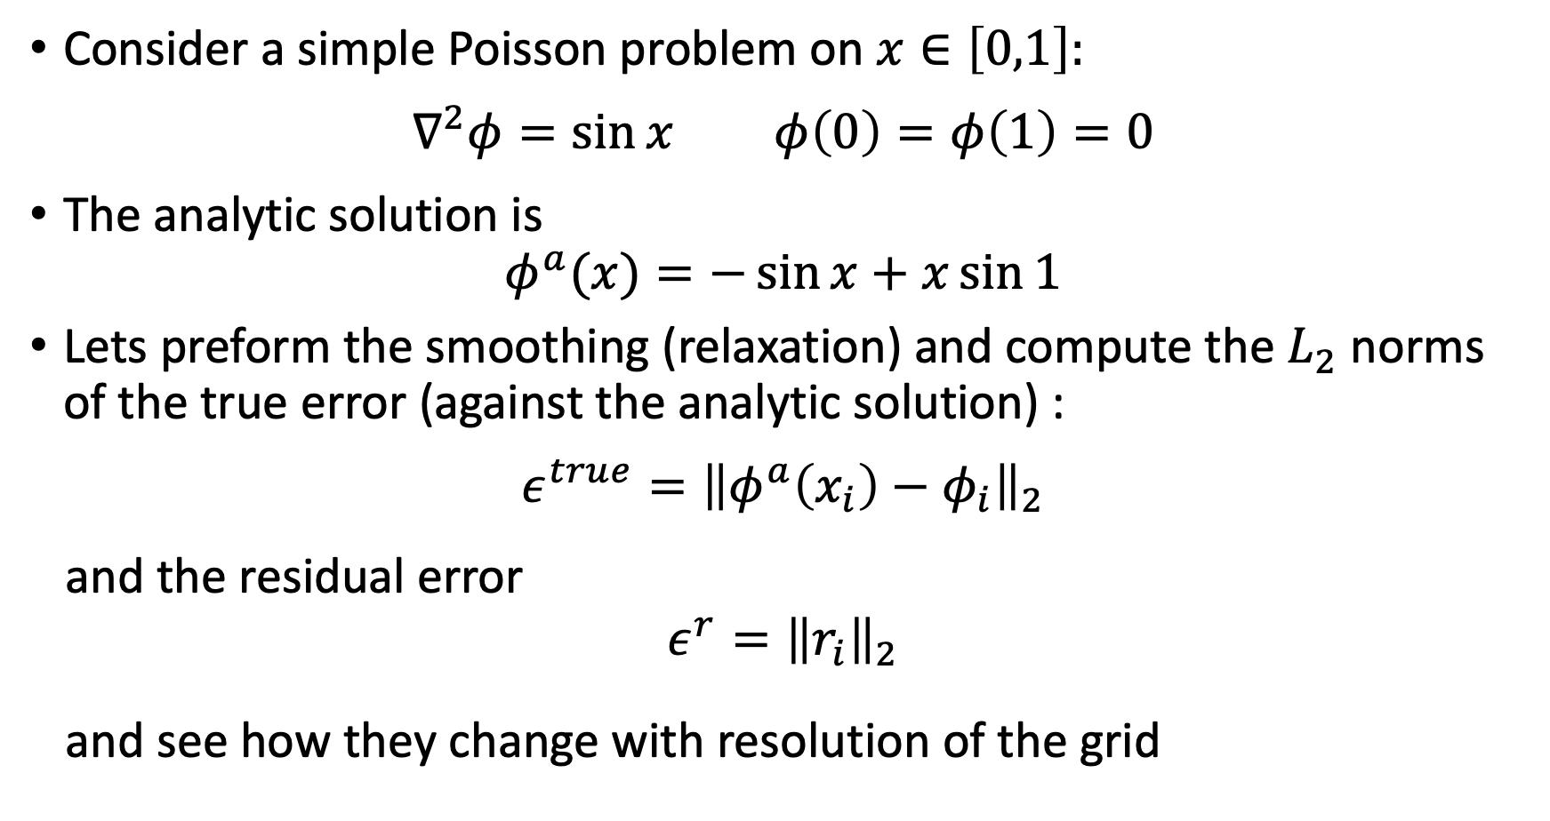
Performance
Consider a simple Poisson problem on $x∈\left[0,1\right]:$
$$∇^{2}φ=\sin{x} φ\left(0\right)=φ\left(1\right)=0$$
The analytic solution is
$$φ^{a}(x)=−\sin{x}+x\sin{1}$$
Lets preform the smoothing (relaxation) and compute the $L_{2}$ norms of the true error (against the analytic solution) :
$$ε^{true}={\left\|φ^{a}\left(x_{i}\right)−φ_{i}\right\|}_{2}$$
and the residual error
$${ε^{r}=\left\|r_{i}\right\|}_{2}$$
and see how they change with resolution of the grid

Slide 58
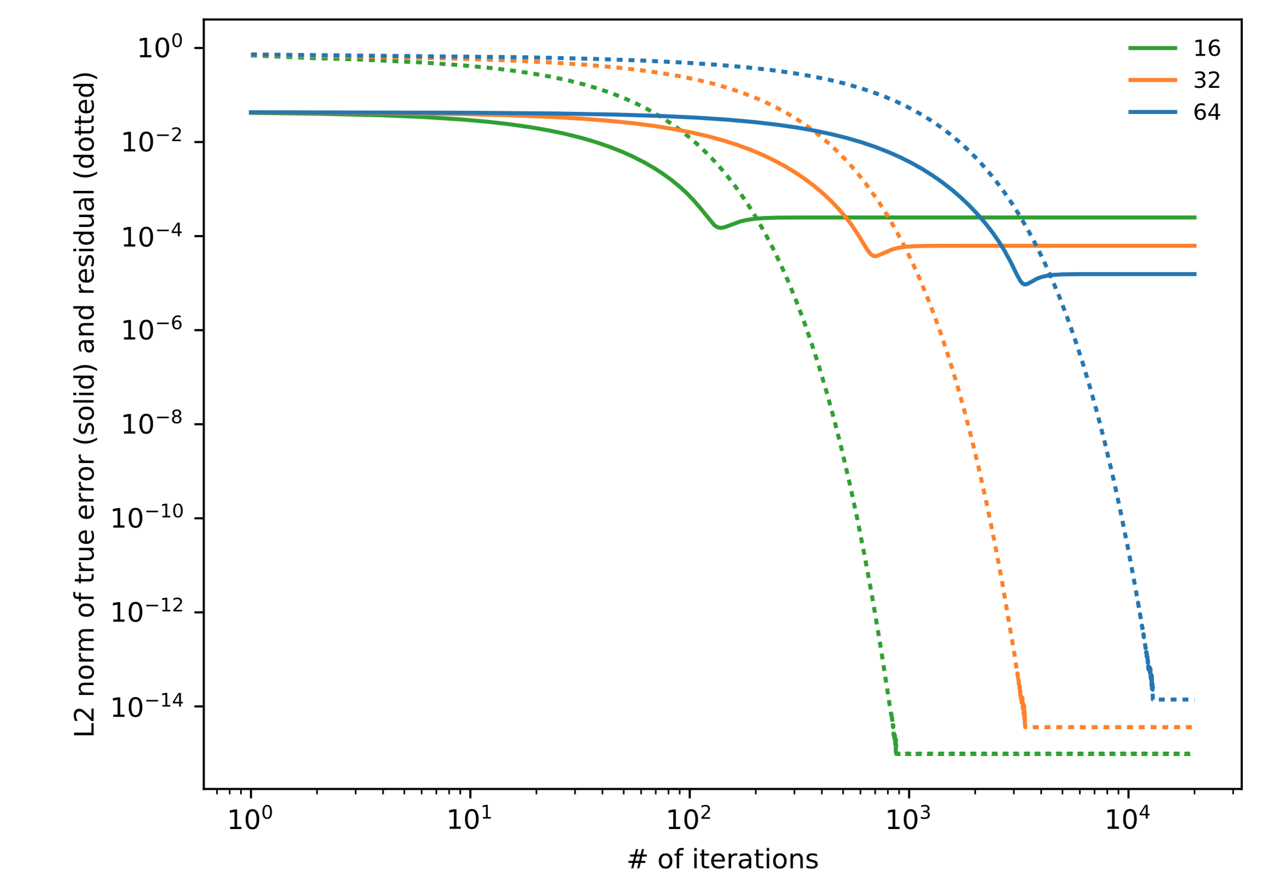
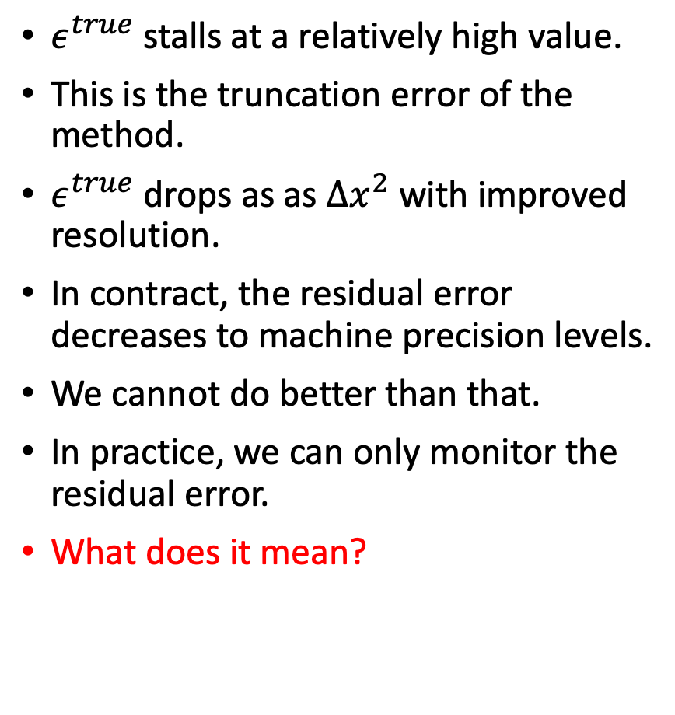


Error decency on normalization
$ε^{true}$stalls at a relatively high value.
This is the truncation error of the method.
$ε^{true}$drops as as $∆x^{2}$ with improved resolution.
In contract, the residual error decreases to machine precision levels.
We cannot do better than that.
In practice, we can only monitor the residual error.
What does it mean?
$$ε^{true}$$
$$ε^{r}$$
Notes:
Numerical derivative of the numerically obtained solution give the desired function to machine precision. But the solution itself is different than the analytic one to an accuracy dictated by the truncation error or order of approximation of the derivative. The later cannot be improved.

Slide 59
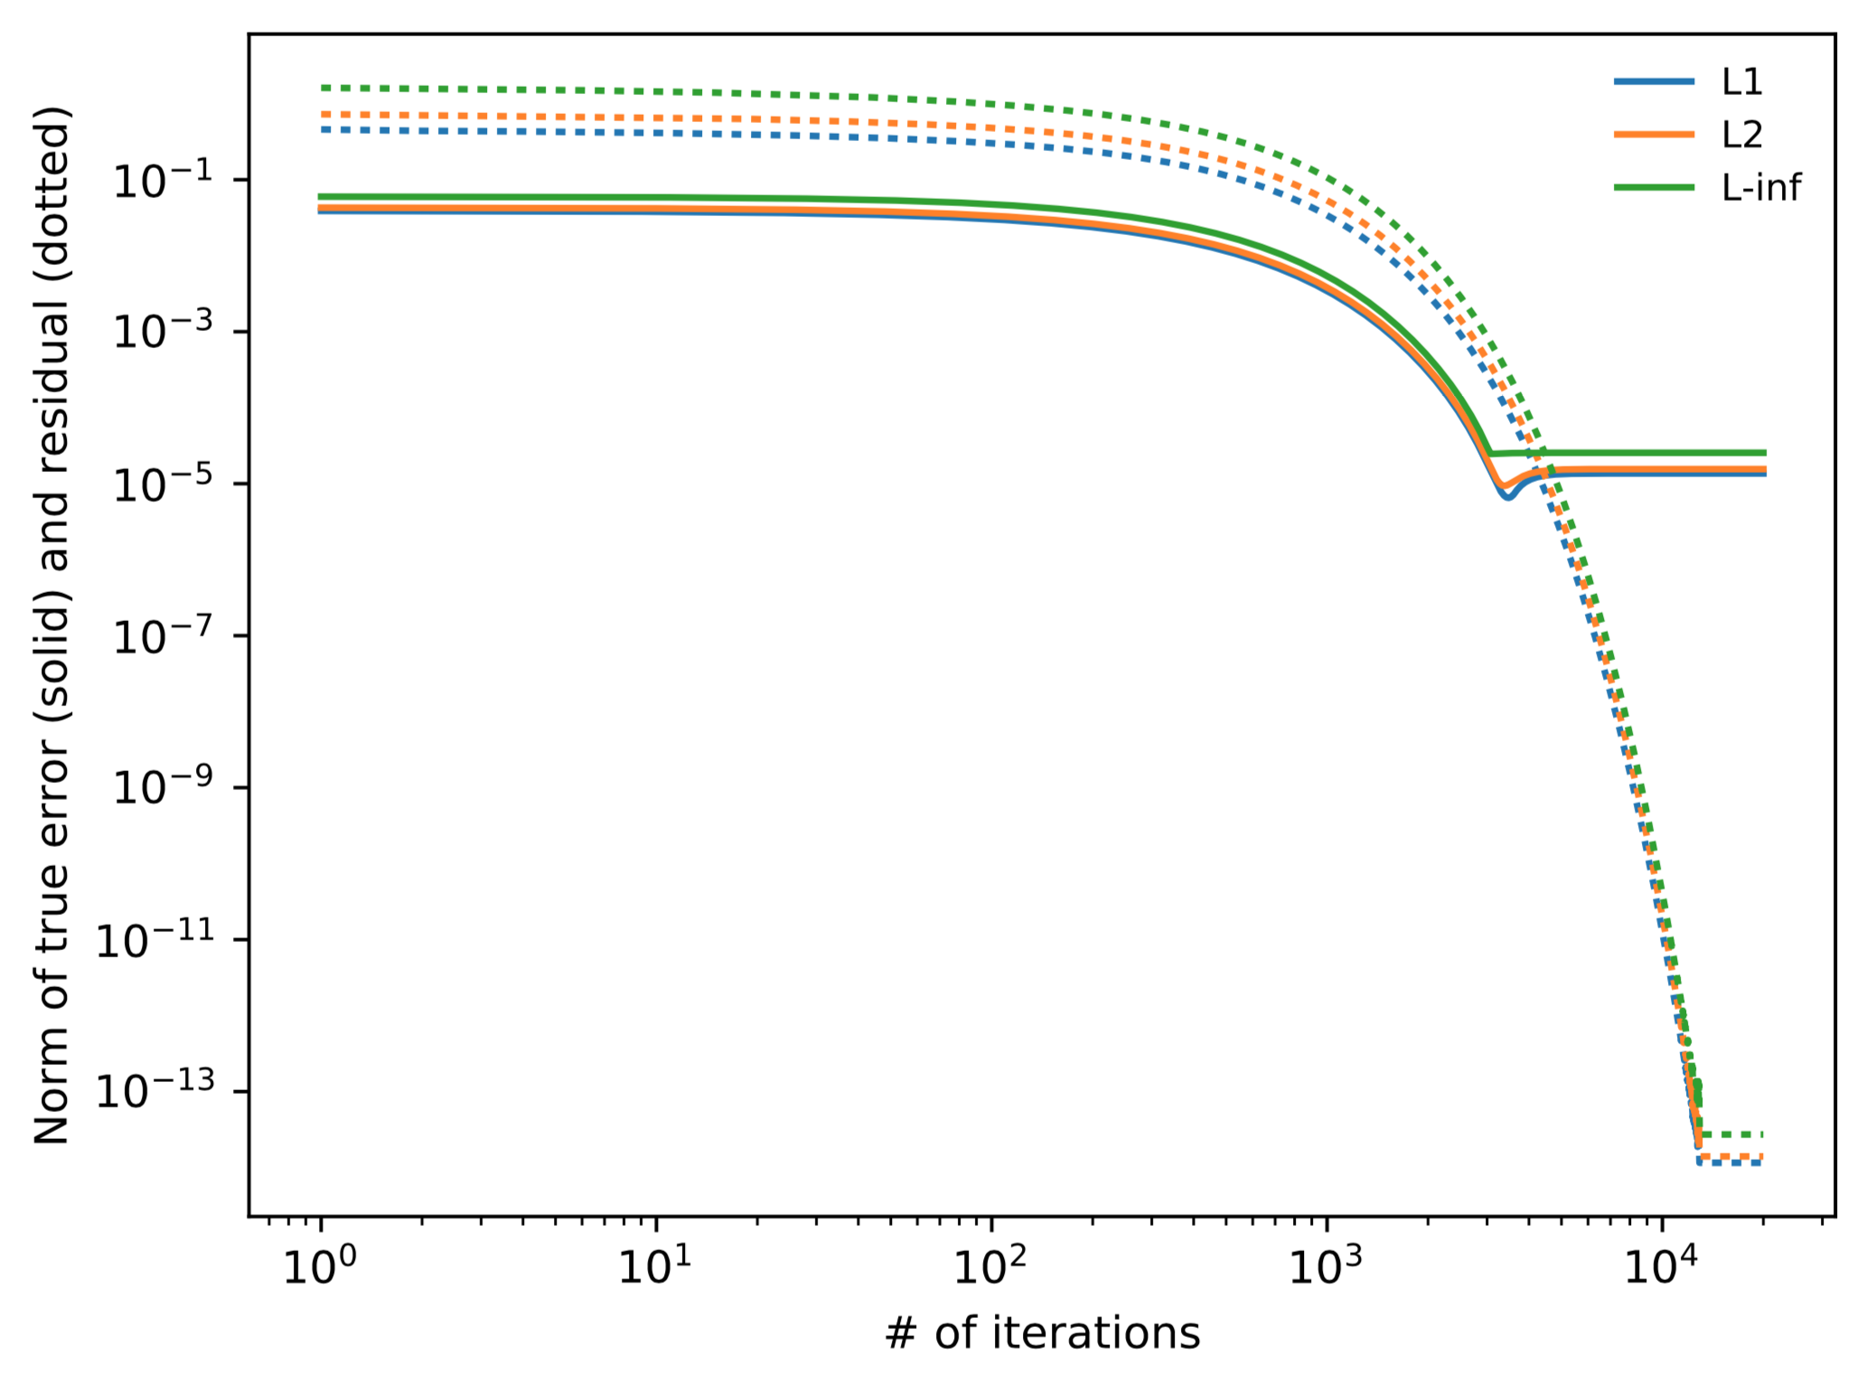
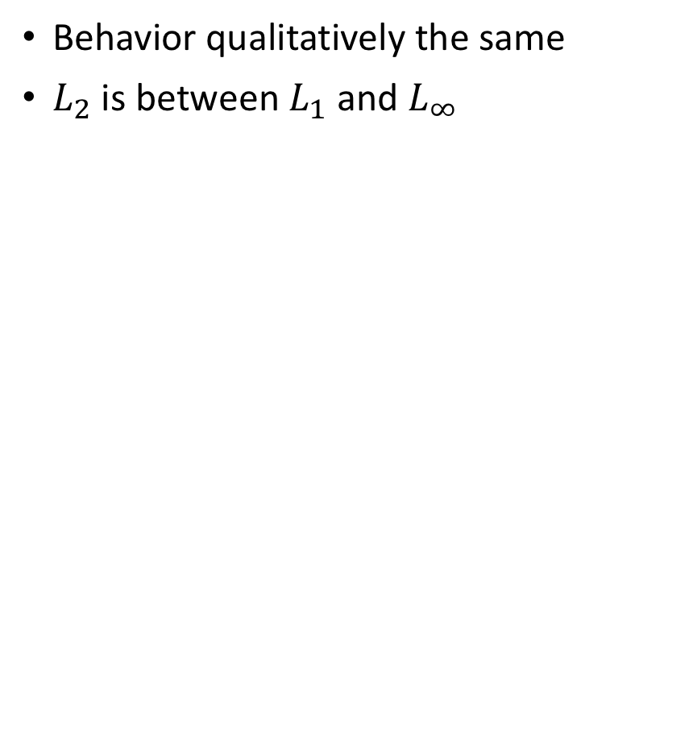



Error decency on normalization
Behavior qualitatively the same
$L_{2}$ is between $L_{1}$ and $L_{∞}$
$$e^{true}$$
$$ε^{true}$$
$${\left\|r_{i}\right\|}_{2}$$
$$ε^{r}$$

Slide 60
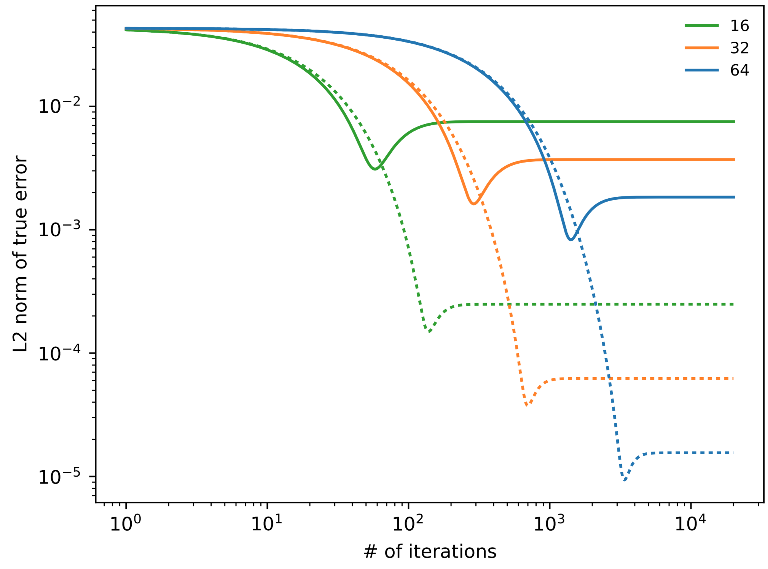


Error decency on boundary conditions
Solid lines: First order BC implementation: initializing the ghost cell to the boundary value
Dotted lines : Second order BC implementation: average the zone values on either side of the interface to get the boundary condition
$$ε^{true}$$
$$ε^{true}$$

Slide 61
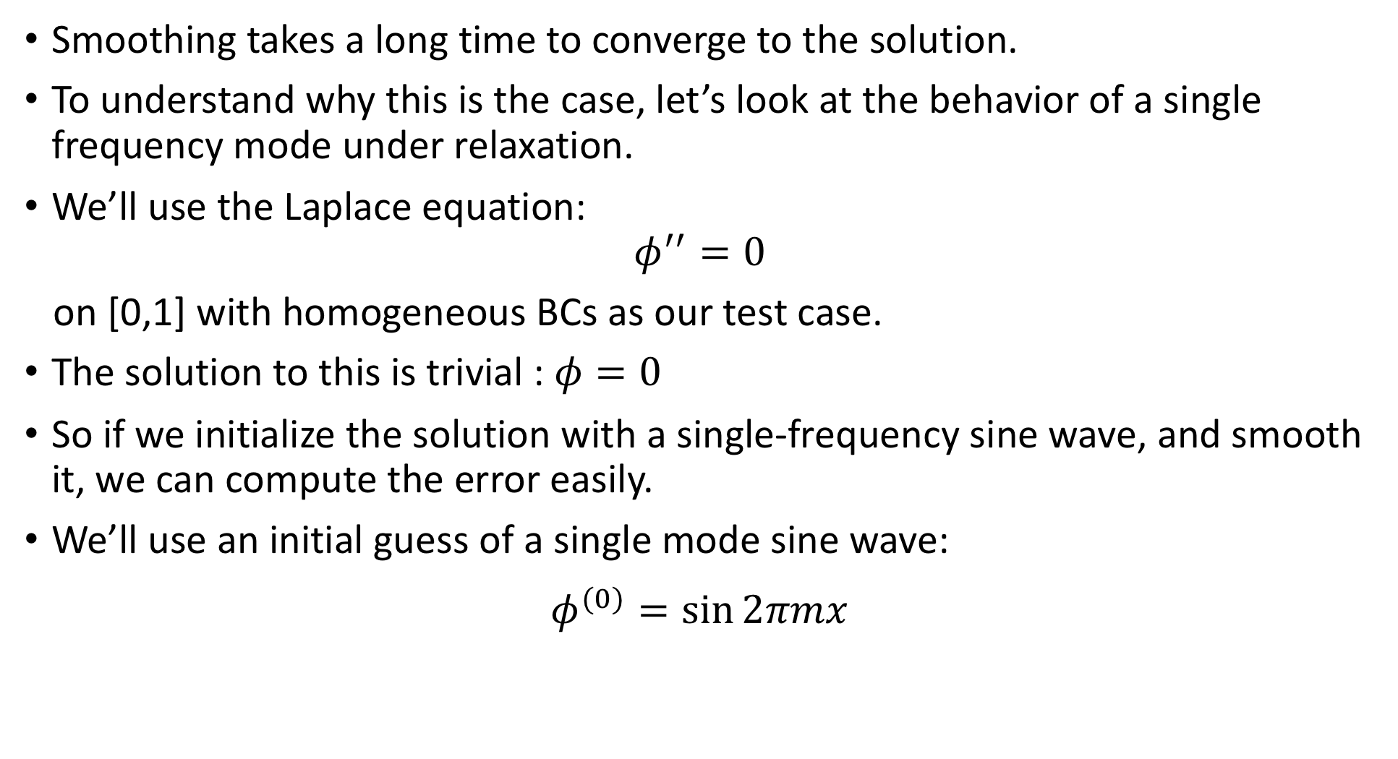
Behavior of a single mode
Smoothing takes a long time to converge to the solution.
To understand why this is the case, let’s look at the behavior of a single frequency mode under relaxation.
We’ll use the Laplace equation:
$$φ^{′′}=0$$
on [0,1] with homogeneous BCs as our test case.
The solution to this is trivial : $φ=0$
So if we initialize the solution with a single-frequency sine wave, and smooth it, we can compute the error easily.
We’ll use an initial guess of a single mode sine wave:
$$φ^{(0)}=\sin{2πmx}$$

Slide 62
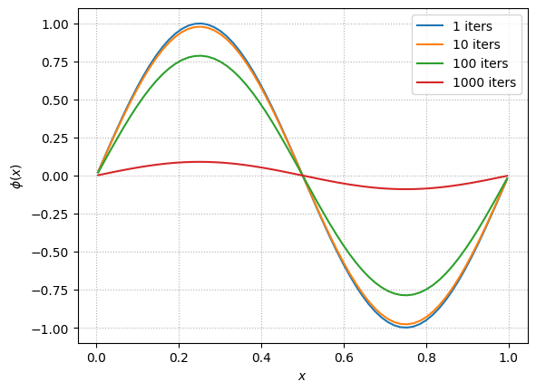

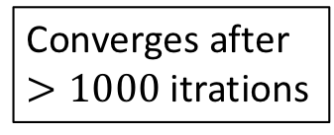
Relaxation with of a sine wave with $m=1$
The errors are
deviation from 0
Converges after
$>1000$ itrations

Slide 63
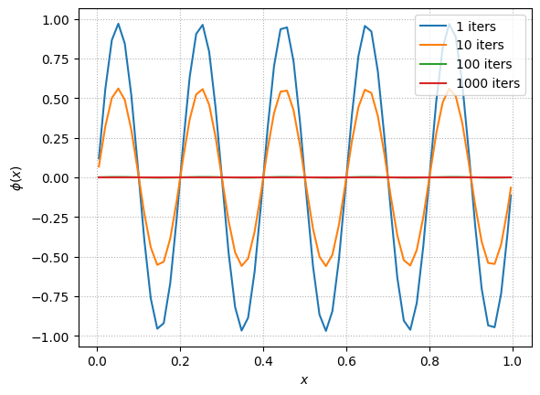


Relaxation with of a sine wave with $m=5$
The errors are
deviation from 0
Converges after
$>100$ itrations

Slide 64



Relaxation with of a sine wave with $m=10$
The errors are
deviation from 0
Converges after
$>10$ itrations

Slide 65


Relaxasion of a 3 wave sine ($m=1,5,10)$

Slide 66
Frequency dependent relaxation
Long wavelength modes take a long time to relax away while short wavelength modes relax very quickly.
In the calculation every zone is coupled to its closest neighbors.
Each iteration increases the coupling length and smooths out variations between more distant cells.
Short wavelength noise (in number of cells) are smoothed out after a few iteration.
Very long wavelength error requires many iterations to be smoothed out.
Since functions are superpositions of many waves they can take long time to relax.
If the problem can be solved on a coarser grid, the error will be of shorter wavelength, and smoothing will be more efficient.

Slide 67


Example of coarse grid relaxation, ${m=2, n}_{x}=64$
The errors are
deviation from 0
Converges after
$>100$ itrations

Slide 68


Example of coarse grid relaxation, ${m=2, n}_{x}=32$
The errors are
deviation from 0
Converges after
$>10$ itrations

Slide 69


Example of coarse grid relaxation, ${m=2, n}_{x}=32$
The errors are
deviation from 0
Converges after
$>1$ itrations

Slide 70
Multigrid
To build a multigrid algorithm we need a way to coarsen our problem and then bring what we learned on the coarse grid back up to the fine grid.
We to transfer data between grids at different resolutions and use it to accelerate the convergence of the relaxation.
The procedure depends on the type of grid we are using.
We’ll consider a cell-centered finite-difference / finite-volume grid.
Since the finite-volume method is conservative, we want to ensure that the operations that we do here maintain that conservation.

Slide 71

Restriction and Prolongation
Consider the following 2 grids
The fine grid (top) is indexed with $i$ and the coarse grid (bottom) is indexing with $j$.
The grids are properly nested: two fine cells fit exactly into a single coarse cell.
Transferring data from a fine grid to a coarser grid - restriction
Transferring data from a coarse grid to a finer grid – prolongation

Slide 72













Restriction – 1D
Transferring data to coarser grid in 1D.
If $φ$ represents a density, then conservation requires:
$$φ_{j}^{c}=\frac{1}{Δx^{c}}\left(Δx_{i}^{f}φ_{i}^{f}+Δx_{i+1}^{f}φ_{i+1}^{f}\right)=\frac{1}{2}\left(φ_{i}^{f}+φ_{i+1}^{f}\right)$$
This is also second-order accurate at the coarse cell, cell-center.
(in our case)
$$φ_{i−2}^{f}$$
$$φ_{i−1}^{f}$$
$$φ_{i}^{f}$$
$$φ_{i+1}^{f}$$
$$i−2$$
$$i−1$$
$$i$$
$$i+1$$
$$φ_{j−1}^{c}$$
$$φ_{j}^{c}$$
$$j−1$$
$$j$$

Slide 73

Restriction – 2D
In 2D for proper nested cells we get
$$φ_{i,j}^{c}=\frac{1}{4}\left(φ_{−−}^{f}+φ_{+−}^{f}+φ_{−+}^{f}+φ_{++}^{f}\right)$$
again this is just averaging over the
densities in the coarse cell.

Slide 74

Prolongation – 1D (1st order accuracy)
To initialize the two fine cells from a coarse cell, we could simply do
$$φ_{i}^{f}=φ_{i+1}^{f}=φ_{j}^{c}$$
This is only first order accurate.
$$φ_{i−2}^{f}$$
$$φ_{i−1}^{f}$$
$$φ_{i}^{f}$$
$$φ_{i+1}^{f}$$
$$i−2$$
$$i−1$$
$$i$$
$$i+1$$
$$φ_{j−1}^{c}$$
$$φ_{j}^{c}$$
$$j−1$$
$$j$$

Slide 75



Prolongation – 1D (2nd order accuracy)
A second-order accurate method of starts with reconstructing the coarse data linearly:
$$φ^{c}\left(x\right)=m_{x}\left(x−x_{j}^{c}\right)+φ_{j}^{c} ; m_{x}=\frac{φ_{j+1}^{c}−φ_{j−1}^{c}}{2Δx^{c}}$$
$$φ_{i−2}^{f}$$
$$φ_{i−1}^{f}$$
$$φ_{i}^{f}$$
$$φ_{i+1}^{f}$$
$$i−2$$
$$i−1$$
$$i$$
$$i+1$$
$$φ_{j−1}^{c}$$
$$φ_{j}^{c}$$
$$φ_{j+1}^{c}$$
$$j−1$$
$$j$$
$$j+1$$

Slide 76

Prolongation – 1D (2nd order accuracy)
To second-order, we can find the values of $φ_{i}^{f}$ and $φ_{i+1}^{f}$by evaluating $φ\left(x\right)$ at the corresponding $x$ coordinates:
$$x_{i}^{f}=x_{j}^{c}−\frac{Δx^{c}}{4}, x_{i+1}^{f}=x_{j}^{c}+\frac{Δx^{c}}{4}$$
$$φ_{i−2}^{f}$$
$$φ_{i−1}^{f}$$
$$φ_{i}^{f}$$
$$φ_{i+1}^{f}$$
$$i−2$$
$$i−1$$
$$i$$
$$i+1$$
$$φ_{j−1}^{c}$$
$$φ_{j}^{c}$$
$$φ_{j+1}^{c}$$
$$j−1$$
$$j$$
$$j+1$$

Slide 77

Prolongation – 1D (2nd order accuracy)
To second-order, we can find the values of $φ_{i}^{f}$ and $φ_{i+1}^{f}$by evaluating $φ\left(x\right)$ at the corresponding $x$ coordinates:
$$x_{i}^{f}=x_{j}^{c}−\frac{Δx^{c}}{4}, x_{i+1}^{f}=x_{j}^{c}+\frac{Δx^{c}}{4}$$
giving
$$φ_{i}^{f}=φ_{i}^{c}−\frac{1}{8}\left(φ_{j+1}^{c}−φ_{j−1}^{c}\right)$$
$$φ_{i+1}^{f}=φ_{i}^{c}+\frac{1}{8}\left(φ_{j+1}^{c}−φ_{j−1}^{c}\right)$$
* The scheme is conservative, since $Δx^{f}\left(φ_{i}^{f}+φ_{i+1}^{f}\right)=Δx^{c}φ_{j}^{c}$

Slide 78

Prolongation – 2D (2nd order accuracy)
A linear reconstruction of the coarse data in x and y is
$$φ\left(x,y\right)=\frac{m_{x}}{Δx^{c}}\left(x−x_{i}^{c}\right)+\frac{m_{y}}{Δy^{c}}\left(y−y_{j}^{c}\right)+φ_{i,j}^{c}$$
with slopes
$$m_{x}=\frac{1}{2}(φ_{i+1,j}^{c}−φ_{i−1,j}^{c})$$
$$m_{y}=\frac{1}{2}(φ_{i,j+1}^{c}−φ_{i,j−1}^{c})$$

Slide 79

Prolongation – 2D (2nd order accuracy)
The fine cells coordinates are
$$x_{±}^{f}=x_{i}^{c}±\frac{Δx^{c}}{4}$$
$$y_{±}^{f}=y_{i}^{c}±\frac{Δy^{c}}{4}$$
giving
$$φ_{±±}^{f}=φ_{i,j }^{c}±\frac{1}{4}m_{x}±\frac{1}{4}m_{y}$$

Slide 80


Multigrid cycle
We smooth on the current grid solving
$$Lφ_{i,j}=f_{i,j}$$
compute the residuals, $r_{i,j}=Lφ_{i,j}−f_{i,j}$
We then restrict $r_{i,j}$ to a coarser grid and smooth on that grid solving
$$Le_{i,j}=r_{i,j}$$
compute the new residuals $r_{i,j}^{k+1}=Le_{i,j}^{k}−r_{i,j}^{k}$
We repeat stage 2 with $r_{i,j}^{k+1}$ until we reach a sufficiently coarse grid.
We then prolongate the error $e_{i,j}$ back up and use it to correct the solution on the finer grid.
We do some smoothing and repeat stage 4.

Slide 81



















Multigrid cycle
$$Lφ^{h}=f^{h} ;φ_{0}^{h}$$
r’$=f^{h}−Lφ^{h}$
$$φ_{0}^{h}=φ^{old}+e^{h′}$$
We smooth on the current grid solving
$$Lφ_{i,j}=f_{i,j}$$
compute the residuals, $r_{i,j}=Lφ_{i,j}−f_{i,j}$
We then restrict $r_{i,j}$ to a coarser grid and smooth on that grid solving
$$Le_{i,j}=r_{i,j}$$
compute the new residuals $r_{i,j}^{k+1}$
We repeat stage 2 with $r_{i,j}^{k+1}$ until we reach a sufficiently coarse grid.
We then prolongate the error $e_{i,j}$ back up and use it to correct the solution on the finer grid.
We do some smoothing and repeat stage 4.
$${r′→r}^{2h}$$
$$Le^{2h}=r^{2h};e_{0}^{2h}=0$$
$$r^{2h}′=r^{2h}−Le^{2h}$$
$$e_{0}^{2h}=e^{2h,old}+e^{2h^{′}}$$
$$Le^{2h}=r^{2h};e_{0}^{2h}$$
$$e^{2h}→e^{h′}$$
$${r^{2h}′→r}^{4h}$$
$e^{8h}→e^{4h′}$
$$Le^{4h}=r^{4h}; e_{0}^{4h}=0$$
$$r^{4h}′=r^{4h}−Le^{4h}$$
$$e_{0}^{4h}=e^{4h,old}+e^{4h^{′}}$$
$$Le^{4h}=r^{4h};e_{0}^{4h}$$
$${r^{4h}′→r}^{8h}$$
$e^{8h}→e^{4h′}$
$$Le^{8h}=r^{8h}; e_{0}^{8h}=0$$
$$r^{8h}′=r^{8h}−Le^{8h}$$
$$e_{0}^{8h}=e^{8h, old}+e^{8h}′$$
$$Le^{8h}=r^{8h};e_{0}^{8h}$$
$${r^{8h}′→r}^{16h}$$
$e^{16h}→e^{8h′}$
$$Le^{16h}=r^{16h};{ e}_{0}^{16h}=0$$

Slide 82

Boundary conditions and stopping criteria
The general inhomogeneous boundary conditions apply to the finest level.
The BCs on all restricted levels apply for $Le=r$ are homogeneous, but of the same type (Dirichlet, Neumann, periodic…) as the fine level.
* you can always change the BCs in the finest level to homogeneous by
substituting the expression for the ghost cell in the discrete equation, and
add another term to the RHS (we’ll discuss that).
Each V-cycle should reduce the error by 1 order of magnitude.
We can continue the cycles until $\left\|r\right\|<ε\left\|f\right\|$, where $ε$ is chosen.

Slide 83


Error example in $∇^{2}φ=\sin{x}$
Error in the multigrid solution as a function of V-cycle.
The true error, ∥e∥ stalls at truncation error
The residual error, ∥r∥ reaches roundoff error,
Same behavior is seen with smoothing alone
More on multigrids in zingale book.

Slide 84
Lecture 9 - Parabolic equations: Diffusion & Heat flow
Omer Bromberg
omerbr@tauex.tau.ac.il
Winter 2025/6
Modified from lecture notes by Michael Zingale

Slide 85

Diffusion
Diffusion takes a strongly-peaked concentration of $φ$ and spreads it out.
A diffusive process obeys Fick’s law stating that $φ$ moves from higher to lower concentration at a rate proportional to the gradient
$$\vec{F}=−k\vec{∇}φ$$
We can write the time-rate-of-change of $φ$ as a conservation law:
$$\frac{∂φ}{∂t}+\vec{∇}⋅\vec{F}\left(φ\right)=0$$
giving the diffusion equation
$$\frac{∂φ}{∂t}=∇⋅(k∇φ)$$

Slide 86

Diffusion
$$\frac{∂φ}{∂t}=∇⋅(k∇φ)$$
Diffusion has a time-dependence like the advection equation.
It also has a global character like an elliptic problem.
Unlike advection, there is no sense of upwinding in diffusion (why?)
Notes:
Upwinding calculates the value of a function in the spatially downind cell with respect to a given velocity u. Here for each cell we need both the information from the previous as well as the next cell.

Slide 87

Explicit Discretization of Diffusion in 1D
In the simple 1D case with a constant $k$ the diffusion equation is
$$\frac{∂φ}{∂t}=k\frac{∂^{2}φ}{∂x^{2}}$$
Ex: discretize the diffusion equation using forward-difference in time and the second derivative in space. What is the order of accuracy in time and in space?

Slide 88

Explicit Discretization of Diffusion in 1D
In the simple 1D case with a constant $k$ the diffusion equation is
$$\frac{∂φ}{∂t}=k\frac{∂^{2}φ}{∂x^{2}}$$
Ex: discretize the diffusion equation using forward-difference in time and the second derivative in space. What is the order of accuracy in time and in space?
$$\frac{{φ_{i}^{n+1}−φ}_{i}^{n}}{Δt}=k\frac{{φ_{i+1}^{n}−2φ}_{i}^{n}+φ_{i−1}^{n} }{Δx^{2}}$$
This scheme is first order accurate in time and second-order accurate in space

Slide 89

Stability
The solution resembles the FTCS method in the advection equation.
We need to examine whether this discretization is stable.
Lets look at the growth of a single Fourier mode of the sort:
$$φ_{i}^{n}=A^{n}e^{−j\tilde{k}x}$$
Stability requires that:
$$\left|\frac{A^{n+1}}{A^{n}}\right|≤1$$

Slide 90

Stability
Ex: given that
$φ_{i}^{n}=A^{n}e^{−j\tilde{k}x}$
$$φ_{i}^{n+1}=A^{n+1}e^{−j\tilde{k}x}$$
$$φ_{i±1}^{n}=A^{n}e^{−j\tilde{k} (x±Δx)}$$
and using the relation
$$2\cos{θ}=e^{jθ}+e^{−jθ}$$
obtain an expression for the ratio $\left|\frac{A^{n+1}}{A^{n}}\right|$by placing these expressions
in the discretized diffusion equation.

Slide 91

Solution:
$$\frac{{φ_{i}^{n+1}−φ}_{i}^{n}}{Δt}=k\frac{{φ_{i+1}^{n}−2φ}_{i}^{n}+φ_{i−1}^{n} }{Δx^{2}}$$
$$\frac{{\left(A^{n+1}−A^{n}\right)e}^{−j\tilde{k}x}}{Δt}=k\frac{A^{n}\left(e^{−j\tilde{k} (x+Δx)}−{2e}^{−j\tilde{k} x}+e^{−j\tilde{k} (x−Δx)}\right)}{Δx^{2}}$$
$$A^{n+1}=A^{n}\left(1+\frac{kΔt}{Δx^{2}}\left(e^{−j\tilde{k} Δx}−2+e^{j\tilde{k} Δx}\right)\right)$$
$$A^{n+1}=A^{n}\left(1+2\frac{kΔt}{Δx^{2}}\left(\cos{\tilde{k}x}−1\right)\right)$$
$$\frac{A^{n+1}}{A^{n}}=\left(1+2\frac{kΔt}{Δx^{2}}\left(\cos{\tilde{k}x}−1\right)\right)$$

Slide 92

Stability
The stability condition we obtained is
$$\left|\frac{A^{n+1}}{A^{n}}\right|=\left|1+2\frac{kΔt}{Δx^{2}}\left(\cos{\tilde{k}x}−1\right)\right|≤1$$
This condition holds for
$$\frac{kΔt}{Δx^{2}}≤\frac{1}{2}$$
The relation is equivalent to the Courant condition in the advection equation where we had
$$𝒞=\frac{uΔt}{Δx}<1$$

Slide 93

Boundary conditions
To complete the solution, we need boundary conditions at the left ($x_{l}$) and right ($x_{r}$) boundaries.
Typical BC used are
Dirichlet fixing the value of $φ$ on the boundary:
$${\left.φ\right|}_{x=x_{l}}=φ_{l} ;{\left.φ\right|}_{x=x_{r}}=φ_{r}$$
Neumann fixing the flux on the boundary :
$${\left.∂_{x}φ\right|}_{x=x_{l}}=φ_{x,l} ;{\left.∂_{x}φ\right|}_{x=x_{r}}=φ_{x,r}$$

Slide 94

Example: time forward method
To test the method we use a gaussian, since in a diffusion a gaussian maintains its shape and only decreases its amplitude:
$$φ\left(x,t\right)=\left(φ_{2}−φ_{1}\right)\sqrt{\frac{t_{0}}{t+t_{0}}}\exp\left(−\frac{1}{4}\frac{{\left(x−x_{c}\right)}^{2}}{k(t+t_{0})}\right)+φ_{1}$$
$φ_{1}$ , $φ_{2}$ are the minimal and maximal ranges of the function,
$x_{c}$ is the coordinate of the canter point

Slide 95


Example: time forward method
$$N_{x}=64$$
$$C≡2\frac{kΔt}{Δx^{2}}=0.8$$

Slide 96

Effect of resolution
$$C≡2\frac{kΔt}{Δx^{2}}=0.8$$
$$t_{max}=10Δt$$
Notes:
Note that if the initial conditions are not well resolve initially, then the solution will be bad

Slide 97


Unstable solution , $C>1$
$$C≡2\frac{kΔt}{Δx^{2}}=2.0$$
$$t_{max}=10Δt$$

Slide 98

Convergence
$$N$$

Slide 99

Implicit methods
We can remove the timestep restriction by using implicit instead of explicit scheme (like in the advection equation).
We first formulate the backward explicit scheme :
$$\frac{{φ_{i}^{n+1}−φ}_{i}^{n}}{Δt}=k\frac{{φ_{i+1}^{n+1}−2φ}_{i}^{n+1}+φ_{i−1}^{n+1} }{Δx^{2}}$$
or
$${φ_{i}^{n+1}−φ}_{i}^{n}=α\left(φ_{i+1}^{n+1}−2φ_{i}^{n+1}+φ_{i−1}^{n+1}\right)$$
with $α=k\frac{Δt}{Δx^{2}}$
This scheme is still 1’st order in time

Slide 100

Implicit methods
A stability analysis examining the growth of a Fourier mode, similar to what we did before gives
$$\left|\frac{A^{n+1}}{A^{n}}\right|=\left|\frac{1}{1−2α\left(\cos{\tilde{k}x}−1\right)}\right|≤1$$
the ratio is always $≤1$ for all $α$ and $\tilde{k}$, so this discretization is
unconditionally stable.
However, the timestep still determines the accuracy.
We can also write the backward scheme as:
$$−αφ_{i+1}^{n+1}+(1+2α){φ_{i}^{n+1}−αφ_{i−1}^{n+1}=φ}_{i}^{n}$$

Slide 101

Implicit methods
$$−αφ_{i+1}^{n+1}+(1+2α){φ_{i}^{n+1}−αφ_{i−1}^{n+1}=φ}_{i}^{n}$$
We obtained a coupled, linear set of algebraic equations for the state of $φ$in the new time.
There are several ways we can solve the system:
direct solve : create a linear system of the form A$x=b$ and solve for the new state using Gaussian elimination or something similar
iterative solve : apply relaxation to the system, just like we did with the elliptic equations.
Note that the implicit discretization is stable for all values of $C$,
however stabilization is different than accuracy.
Notes:
Note that the time step still appears implicitly in the alpha parameter.

Slide 102

Implicit methods: Direct solve
Let us solve the system directly.
In order to write down the complete set we need to formulate the boundary conditions for cells outside of the domain in the first and last equations:
$$−αφ_{lo+1}^{n+1}+(1+2α){φ_{lo}^{n+1}−αφ_{lo−1}^{n+1}=φ}_{lo}^{n}$$
$$−αφ_{hi+1}^{n+1}+(1+2α){φ_{hi}^{n+1}−αφ_{hi−1}^{n+1}=φ}_{hi}^{n}$$
right ghost
cell
left ghost
cell

Slide 103

Implicit methods: Direct solve
$$−αφ_{lo+1}^{n+1}+(1+2α){φ_{lo}^{n+1}−αφ_{lo−1}^{n+1}=φ}_{lo}^{n}$$
$$−αφ_{hi+1}^{n+1}+(1+2α){φ_{hi}^{n+1}−αφ_{hi−1}^{n+1}=φ}_{hi}^{n}$$
Homogeneous Neumann at $x_{lo}$ : for Neumann boundary conditions, we want the gradient at the boundary to be zero. To first order:
$$\frac{φ_{lo}−φ_{lo−1}}{Δx}=0$$
Inserting this into the first equation gives
$$−αφ_{lo+1}^{n+1}+(1+α){φ_{lo}^{n+1}=φ}_{lo}^{n}$$
right ghost
cell
left ghost
cell

Slide 104

Implicit methods: Direct solve
$$−αφ_{lo+1}^{n+1}+(1+2α){φ_{lo}^{n+1}−αφ_{lo−1}^{n+1}=φ}_{lo}^{n}$$
$$−αφ_{hi+1}^{n+1}+(1+2α){φ_{hi}^{n+1}−αφ_{hi−1}^{n+1}=φ}_{hi}^{n}$$
Dirichlet at $x_{hi}$ : we want the value at the physical boundary to be specified—we’ll call it $φ_{A}$. To a second-order, this means
$$\frac{φ_{hi}+φ_{hi+1}}{2}=φ_{A}$$
Inserting this into the last equation we find
$$\left(1+3α\right){φ_{hi}^{n+1}−αφ_{hi−1}^{n+1}=φ}_{hi}^{n}+2{αφ}_{A}$$
right ghost
cell
left ghost
cell

Slide 105

Implicit methods: Direct solve
Putting this together, our linear system for implicit diffusion:
This can be solved by standard matrix operations, using a tridiagonal solvers (for example).
Notice that the ghost cells do not appear in this linear system, we are only updating the interior points.

Slide 106

Doing it better
A second-order in time discretization requires us to center the RHS in time.
$$\frac{{φ_{i}^{n+1}−φ}_{i}^{n}}{Δt}=\frac{k}{2}\left(\frac{{φ_{i+1}^{n}−2φ}_{i}^{n}+φ_{i−1}^{n} }{Δx^{2}}+\frac{{φ_{i+1}^{n+1}−2φ}_{i}^{n+1}+φ_{i−1}^{n+1} }{Δx^{2}}\right)$$
This time- discretization is called Crank-Nicolson.
Using the same method as before we get an altered formula
$$−\frac{α}{2}φ_{i+1}^{n+1}+\left(1+α\right)φ_{i}^{n+1}−\frac{α}{2}φ_{i−1}^{n+1}=φ_{i}^{n}+\frac{α}{2}\left(φ_{i+1}^{n}−2φ_{i}^{n}+φ_{i−1}^{n}\right)$$

Slide 107

Doing it better
$$−\frac{α}{2}φ_{i+1}^{n+1}+\left(1+α\right)φ_{i}^{n+1}−\frac{α}{2}φ_{i−1}^{n+1}=φ_{i}^{n}+\frac{α}{2}\left(φ_{i+1}^{n}−2φ_{i}^{n}+φ_{i−1}^{n}\right)$$
Using Homogeneous Neumann BC on the left and right boundaries we have :
$φ_{lo−1}^{n+1}=φ_{lo}^{n+1}$ , $φ_{hi−1}^{n+1}=φ_{hi}^{n+1}$
and our stencil at the boundary becomes
$$−\frac{α}{2}φ_{lo+1}^{n+1}+\left(1+\frac{α}{2}\right)φ_{lo}^{n+1}=φ_{lo}^{n}+\frac{α}{2}\left(φ_{lo+1}^{n}−2φ_{lo}^{n}+φ_{lo−1}^{n}\right)$$

Slide 108


Doing it better
$$−\frac{α}{2}φ_{lo+1}^{n+1}+\left(1+\frac{α}{2}\right)φ_{lo}^{n+1}=φ_{lo}^{n}+\frac{α}{2}\left(φ_{lo+1}^{n}−2φ_{lo}^{n}+φ_{lo−1}^{n}\right)$$
with the matrix form:

Slide 109

Doing it better

Slide 110

Doing it better

Slide 111

Implicit methods: Relaxation
Instead of directly solving the matrix form, we can use multigrid.
Consider the Crank-Nicolson system:
$$\frac{{φ_{i}^{n+1}−φ}_{i}^{n}}{Δt}=\frac{1}{2}\left(k∇^{2}φ_{i}^{n}+k∇^{2}φ_{i}^{n+1}\right)$$
$$φ_{i}^{n+1}−\frac{Δt}{2}k∇^{2}φ_{i}^{n}=φ_{i}^{n}+\frac{Δt}{2}k∇^{2}φ_{i}^{n}$$
This is a form of a constant-coefficient Helmholtz equation:
$$\left(α−β∇^{2}\right)φ^{n+1}=f$$
With $α=1$ , $β=kΔt/2$ , $f=φ_{i}^{n}+\frac{Δt}{2}k∇^{2}φ_{i}^{n}$
Can be solved using multigrid techniques with a Helmholtz operator (See M. Zingale book, chapter 10).

Slide 112


Implicit methods: Relaxation
Instead of directly solving the matrix form, we can use multigrid:
First order in time:
$$\frac{{φ_{i}^{n+1}−φ}_{i}^{n}}{Δt}=k∇^{2}φ_{i}^{n+1}=k\frac{{φ_{i+1}^{n+1}−2φ}_{i}^{n+1}+φ_{i−1}^{n+1} }{Δx^{2}}$$
$$−αφ_{i+1}^{n+1}+(1+2α){φ_{i}^{n+1}−αφ_{i−1}^{n+1}=φ}_{i}^{n}$$
We write the RHS as ${φ_{i}^{n}=f}_{i}$ and express $φ_{i}^{n+1}$:
$$φ_{i}^{n+1}={\left(1+2α\right)}^{−1}\left(f_{i}+αφ_{i+1}^{n+1}+αφ_{i−1}^{n+1}\right)$$
We can use the same class we did for the Poisson equation, but with a modified relaxation and residual routine as well as a time loop encompassing the entire update (See M. Zingale book).
$$α=\frac{kΔt}{Δx^{2}}$$

